Slide 1

Uncertainty Analysis Meets Climate Change
“Au rest, après nous le déluge” Poisson 1757
Roger Cooke
TU Delft Nov. 3 2011

Slide 2
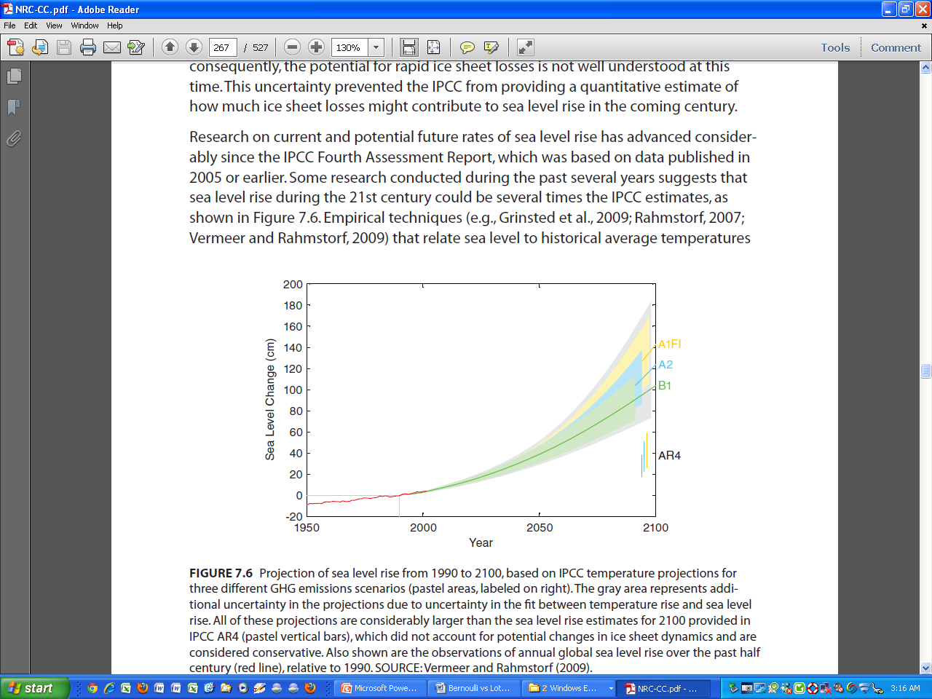

Slide 3
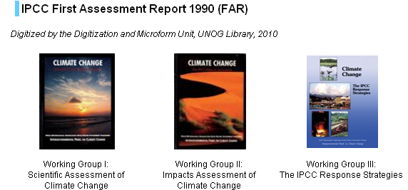
IPCC – Intergovernmental Panel on Climate Change
Fifth Assessment Report

Slide 4
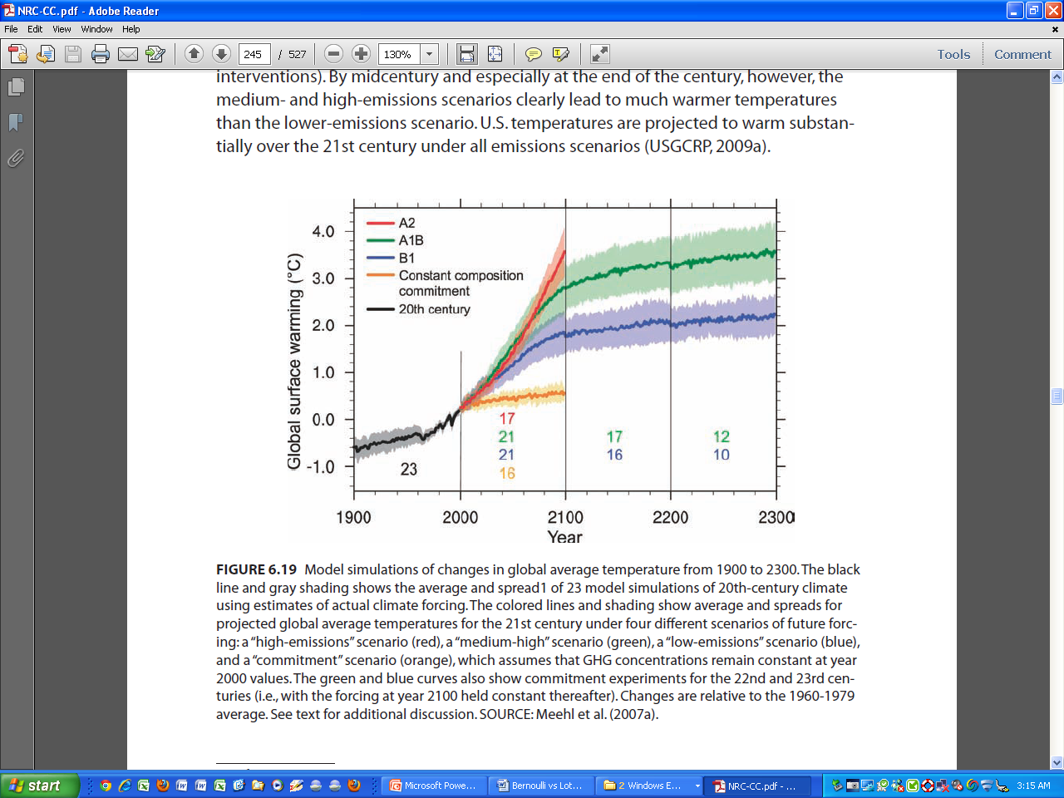
Coupled Model Intercomparison Project: 23 models ± 1 stdev (AR4)
≠ uncertainty

Slide 5
What Are Predicted Impacts of Warming?
5ºC
  collapse of Greenland ice sheet
  large-scale eradication of coral reefs
  disintegration of West Antarctic ice sheet
  shut-down of thermohaline circulation
  millions of additional people at risk of hunger, water shortage, disease, or flooding
  (Parry, Arnell, McMichael et al. 2001; O’Neill and Oppenheimer 2002; Hansen 2005)
11-12°C
  regions inducing hyperthermia in humans and other mammals “would spread to encompass the majority of the human population as currently distributed”
  (Sherwood and Huber 2010)
Uncertainty too deep to quantify ?

Slide 6
“The AR5 will rely on two metrics for communicating the degree of certainty in key findings:”
“Confidence in the validity of a finding, based on the type, amount, quality, and consistency of evidence (e.g., mechanistic understanding, theory, data, models, expert judgment) and the degree of agreement. Confidence is expressed qualitatively.
Quantified measures of uncertainty in a finding expressed probabilistically (based on statistical analysis of observations or model results, or expert judgment).”

Slide 7
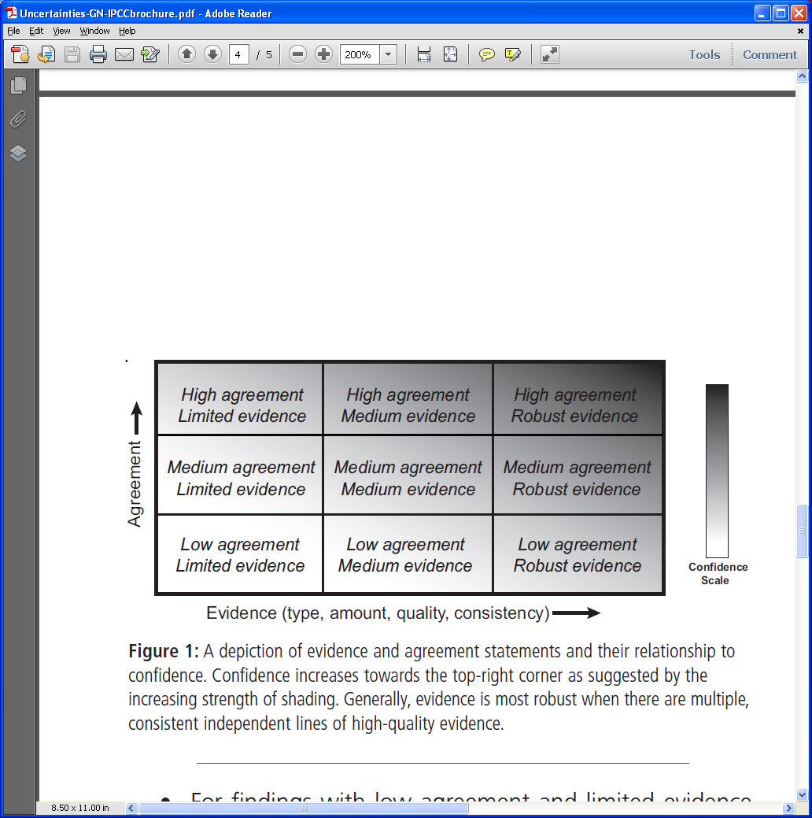
A level of confidence is expressed using five qualifiers: “very low,” “low,” “medium,” “high,” and “very high.”

Slide 8
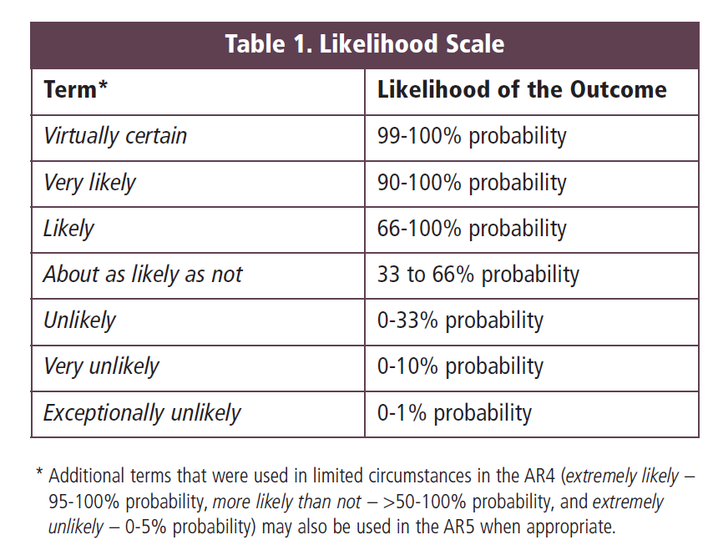
“Likelihood, as defined in Table 1, provides calibrated language for describing quantified uncertainty.”

Slide 9
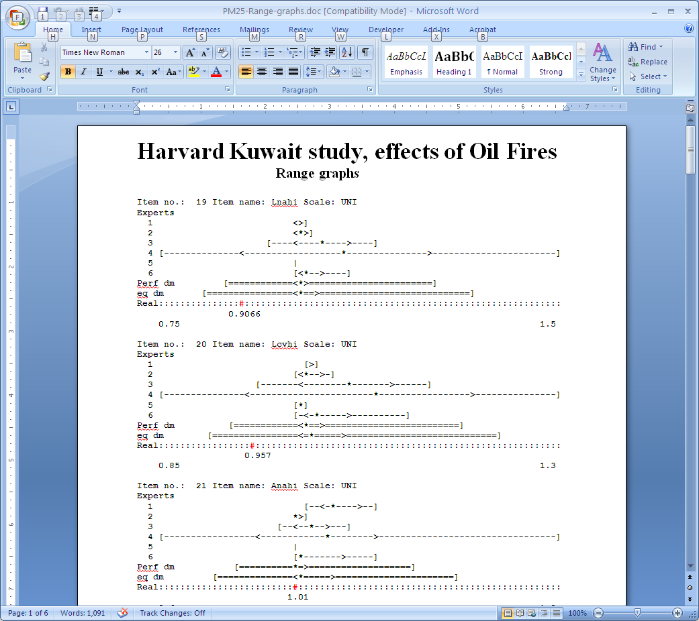
Expert Confidence does NOT predict statistical accuracy

Slide 10
Five conclusions from the US National Research Council National Research Council. (2010). Advancing the science of climate change. Washington, DC: National Academies Press. P.28.
What is the confidence in ALL of these?
high confidence (8 out of 10) or very high confidence (9 out of 10):
“The Earth is warming..”
”Most of the warming over the last several decades can be attributed to human activities”
“Global warming is closely associated with… other climate changes”
“Individually and collectively …these changes pose risks for.. human and environmental systems
“Human-induced climate change and its impacts will continue for many decades, and in some cases for many centuries”
P(Human cause | warming) = 8/10 or
P(Human cause AND warming) = 8/10

Slide 11
Economic Damages of Climate Change:
Model Uncertainty
Stress test
Canonical variations

Slide 12
Neo-Classical Growth
A = total factor productivity, K = capital stock, N = labor, δ = depreciation
Output(t) = A(t) K(t)^{γ} N(t)^{1-γ}
K(t+1) = (1−δ) K(t) + Output(t) – Consump(t)
Bernoulli Equation (1694) Consump(t)=η(t)Output(t) :
dK/dt = −δK(t) + B(t)K(t)^{γ};
η(t) = 0.2, N=6.54 E9, A=0.027
K(t) = [(1 − γ) B∫_{x=o..t} e^{−(1−γ)δx} dx + e^{−(1−γ)δt} K(0) ^{(1−γ)}]^{1/(1−γ)}

Slide 13
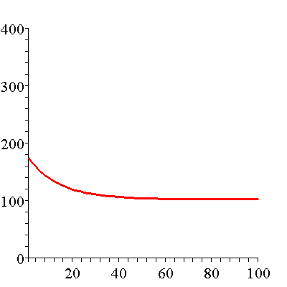
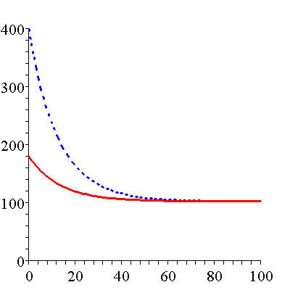
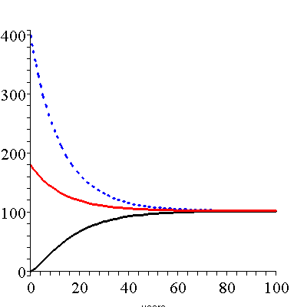
Capital Trajectory
Double Current
Trill USD 2008
Current
1 Dollar
Year

Slide 14
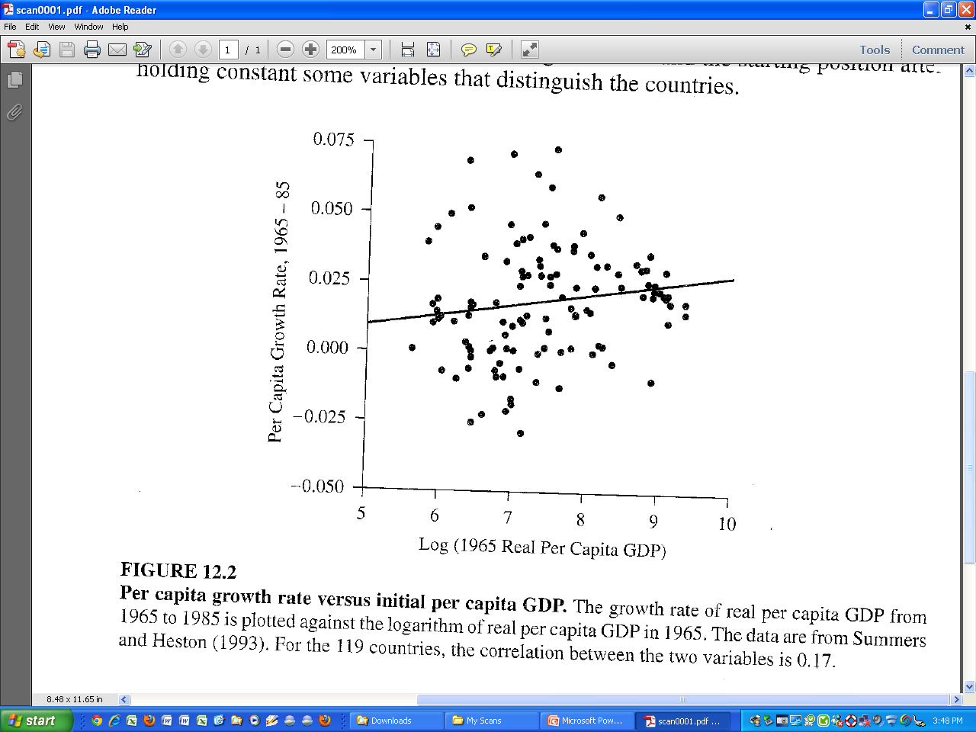
Convergence? Conditional on what?
Barro and Sala-i-Martin 1999, p. 420

Slide 15
Damage from Temperature rise
Λ = abatement, Temp(t) = temperature rise above pre-industrial
[1−Λ(t)] A(t) K(t)^{γ} N(t)^{1-γ}
Output(t) = ——————————
(1 + .0028Temp(t)²)

Slide 16
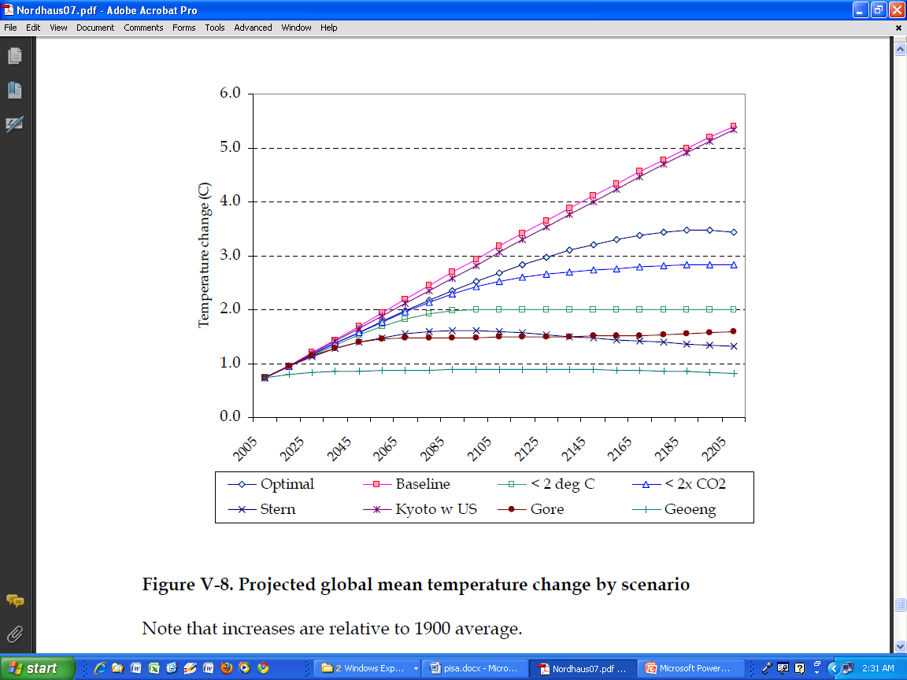

Slide 17
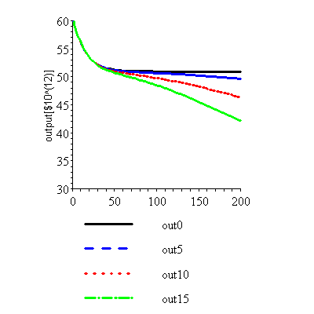
Output[Trill $], outx(t) = output at time t; linear temperature increase No Abatement ; starting capital = 180 [Trill $]

Slide 18
Canonical Variations
Do other simple model forms
have structurally different behavior?

Slide 19
Lotka Volterra vs of Bernoulli Model
Green House Gases [ppmCO₂e]
T(GHG(t)) = cs× ln(GHG(t)/280)/ln(2)
GHG(t+1) = 0.988 × GHG(t) + 0.0047× Biosphere(t) + 0.1 × GWP(t)
• • • • • • • •
GWP(t+1) = [1+ 0.03 − 0.005 × (T(GHG(t)))]GWP(t)
Emissions proportional to Gross World Output DICE initial value [GTC/$Trill 2008)
Gross World Output Growth Rate
(World Bank, last 48 yrs)
Dell et al 2009

Slide 20
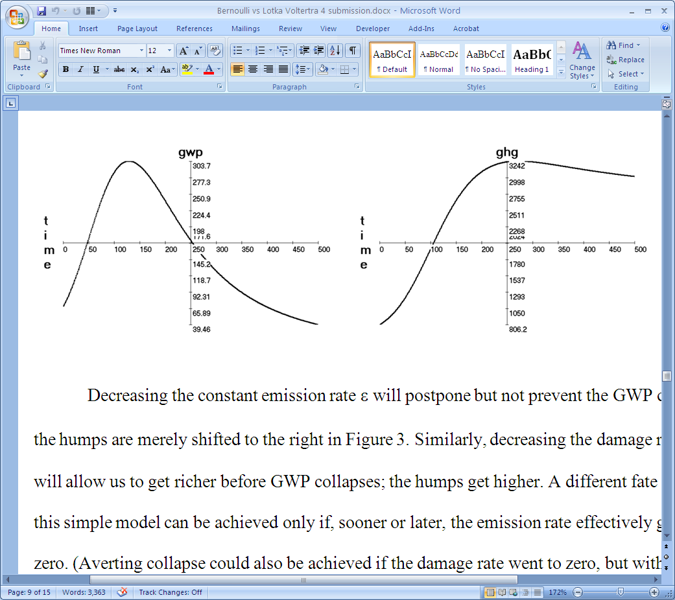

Slide 21
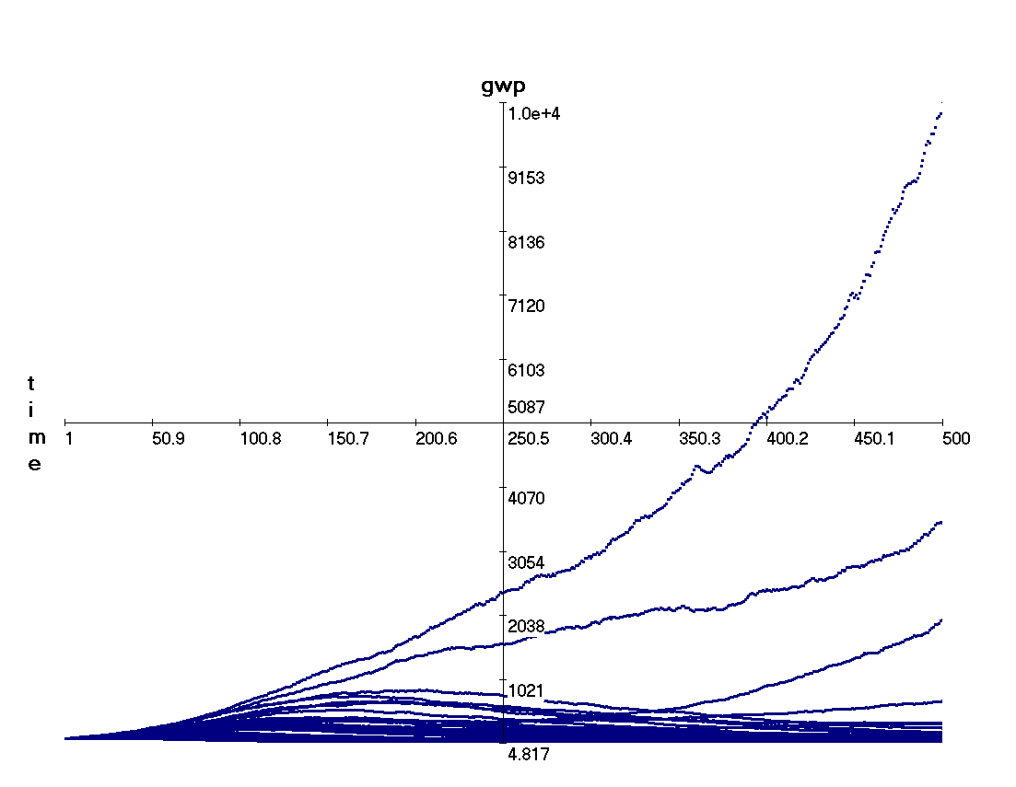
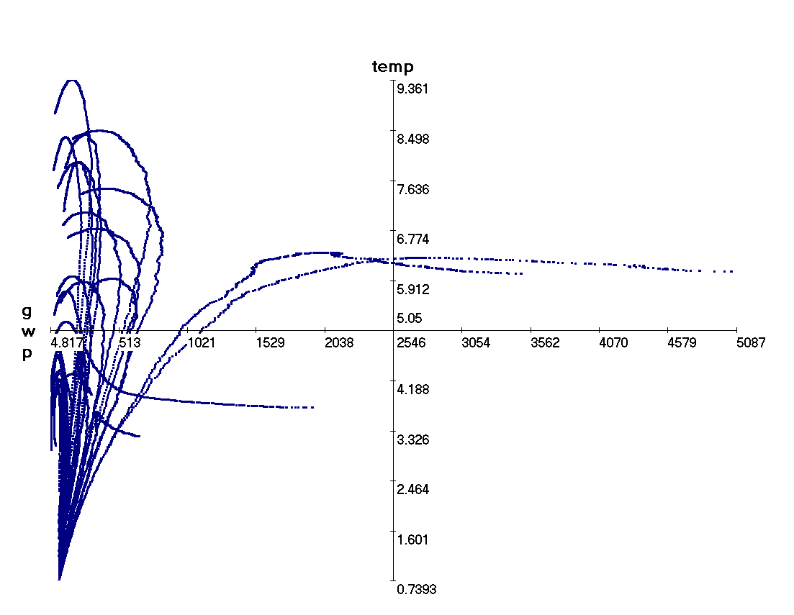
With uncertainty
Phase Portrait

Slide 22
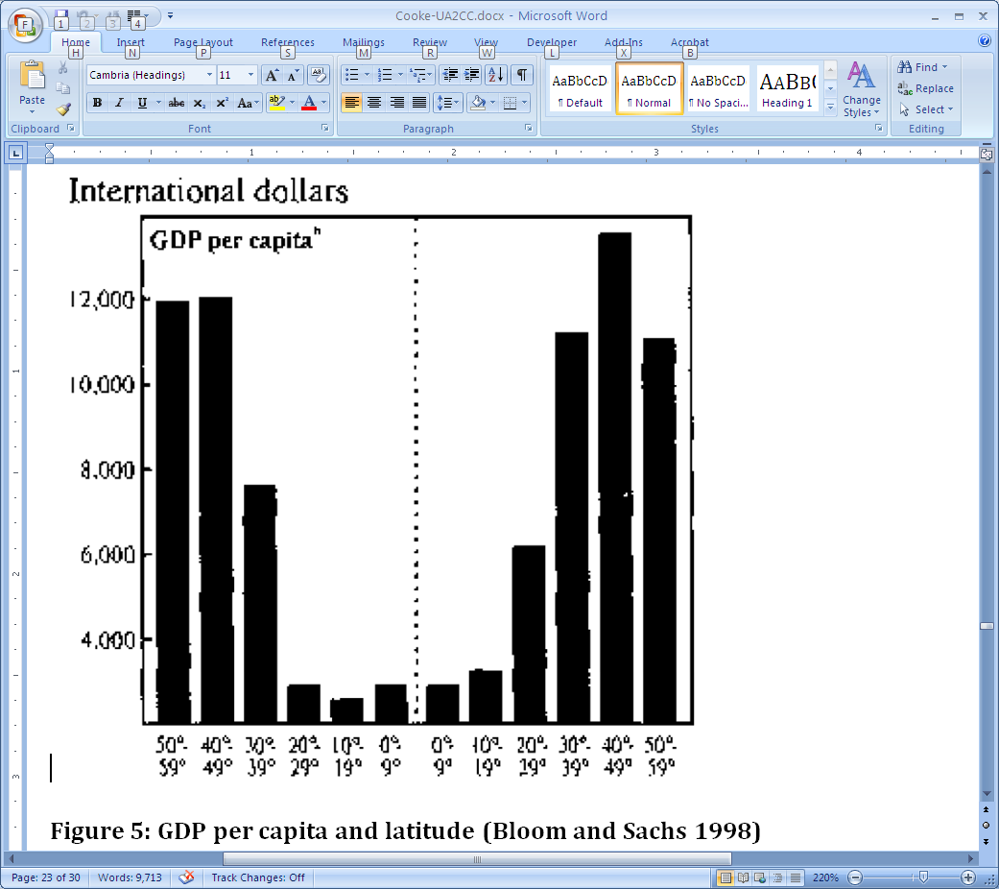
DATA: Geography and Growth

Slide 23
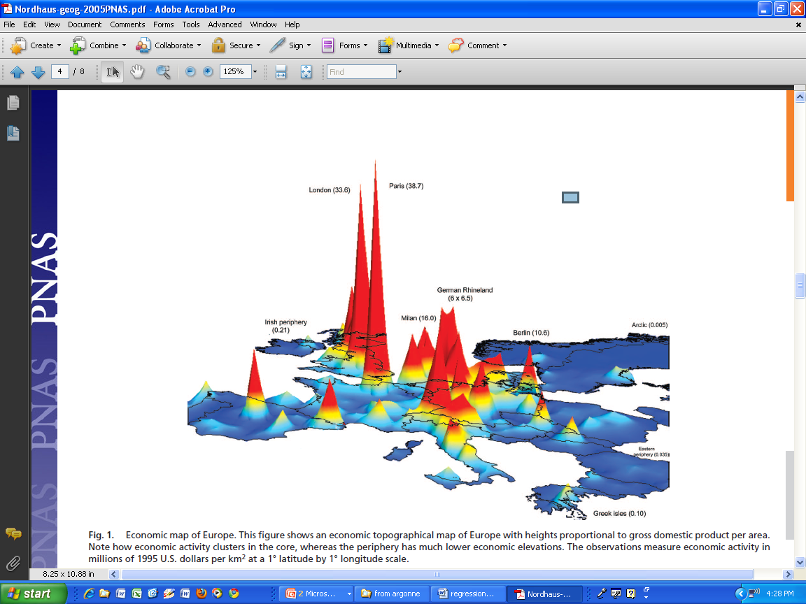
Yale G-Econ Database: Gross Cell Product
GCPpp Time average growth rate:
[Ln(GCPpp) – min[lnGCPpp)] / 400

Slide 24
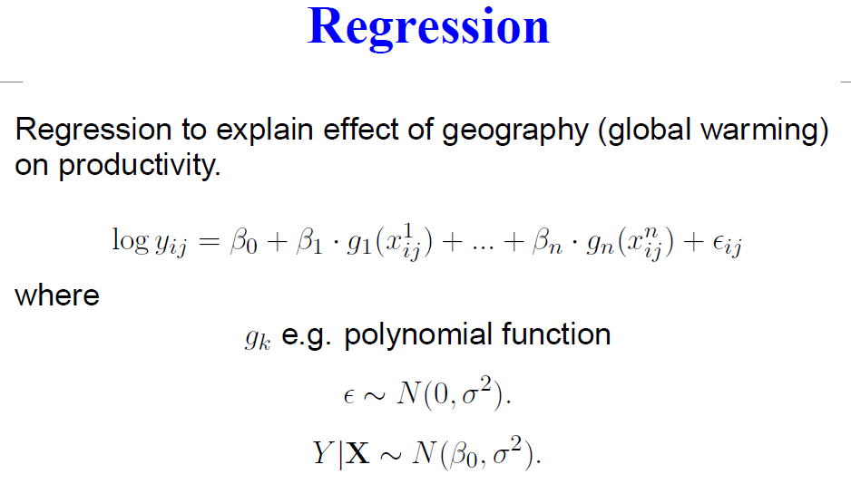

Slide 25
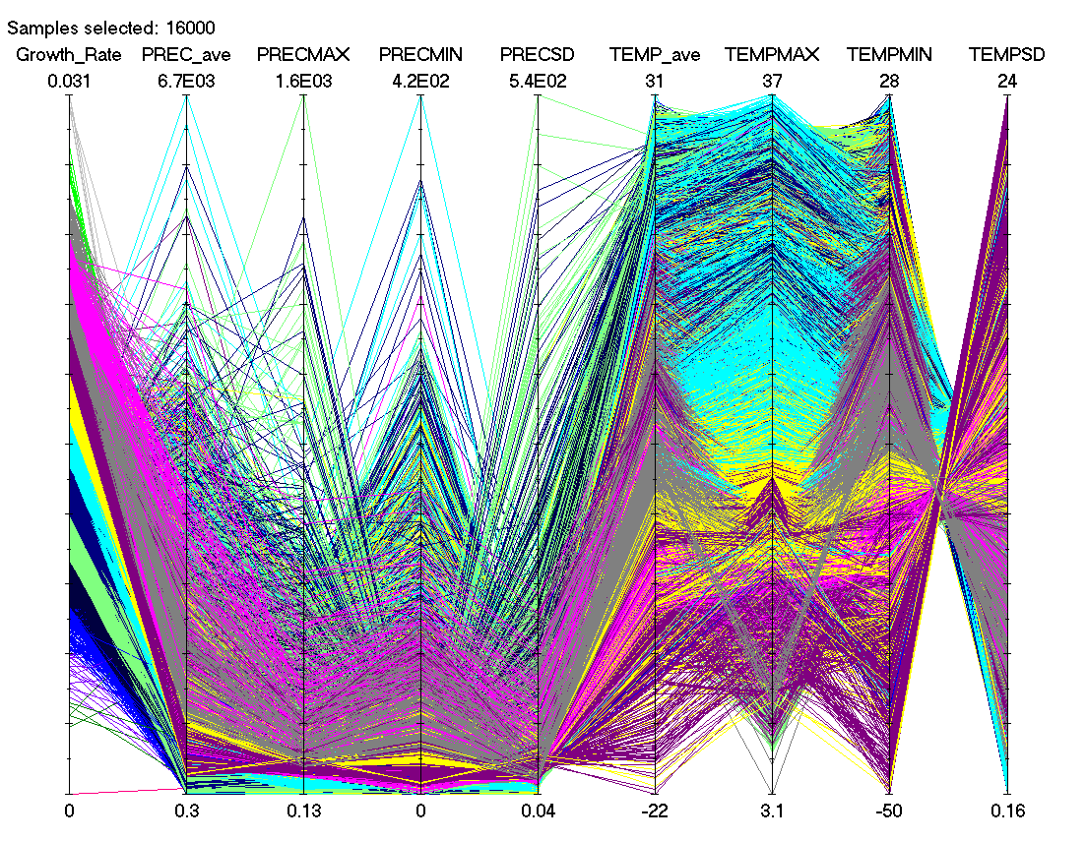

Slide 26
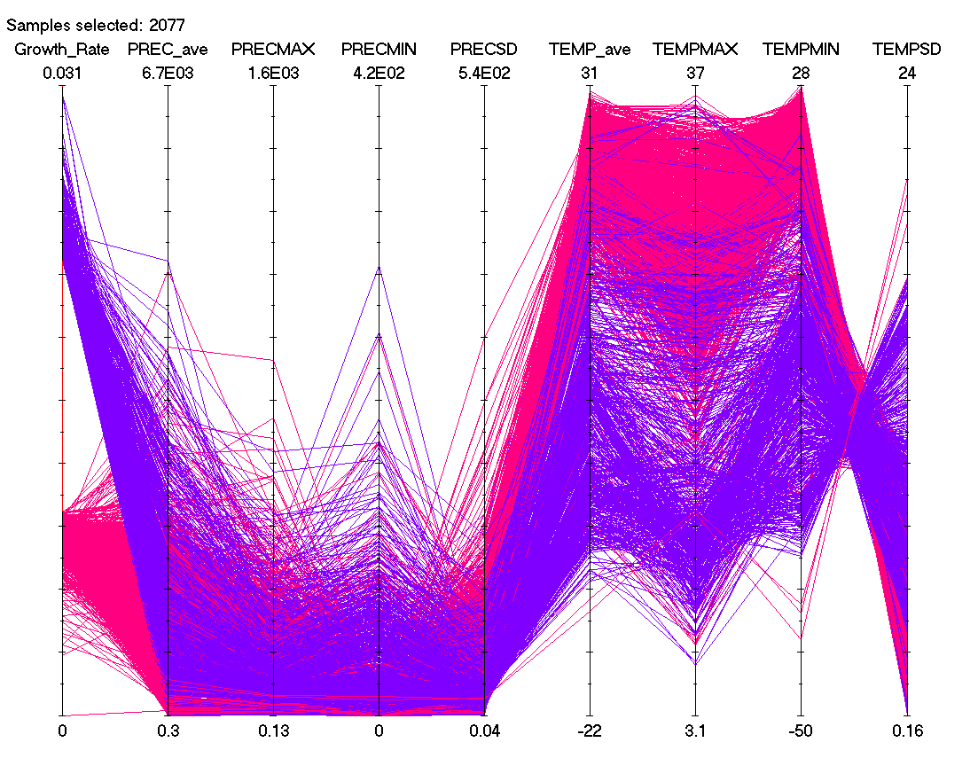

Slide 27
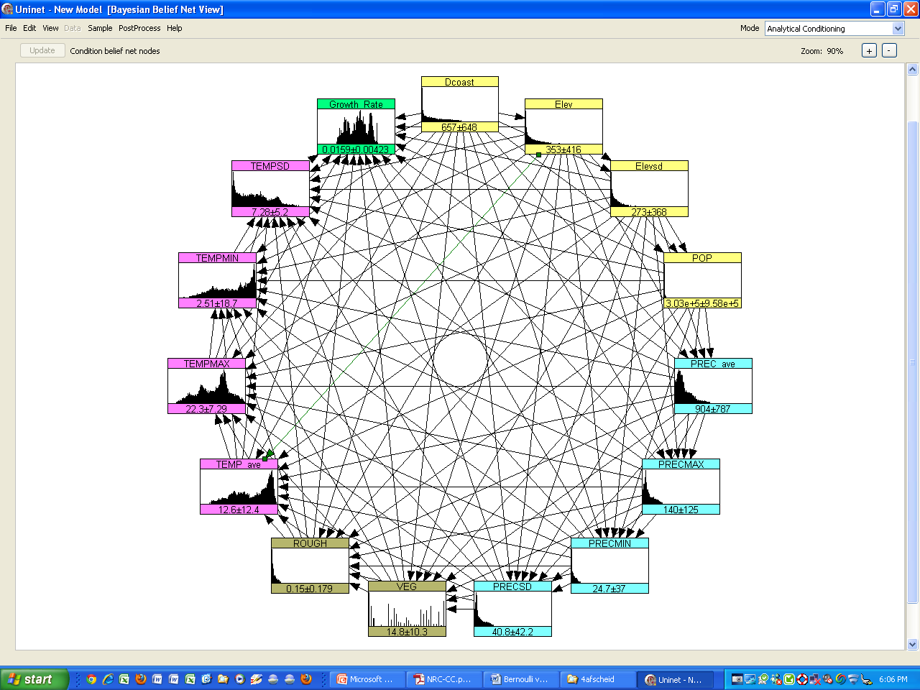

Slide 28
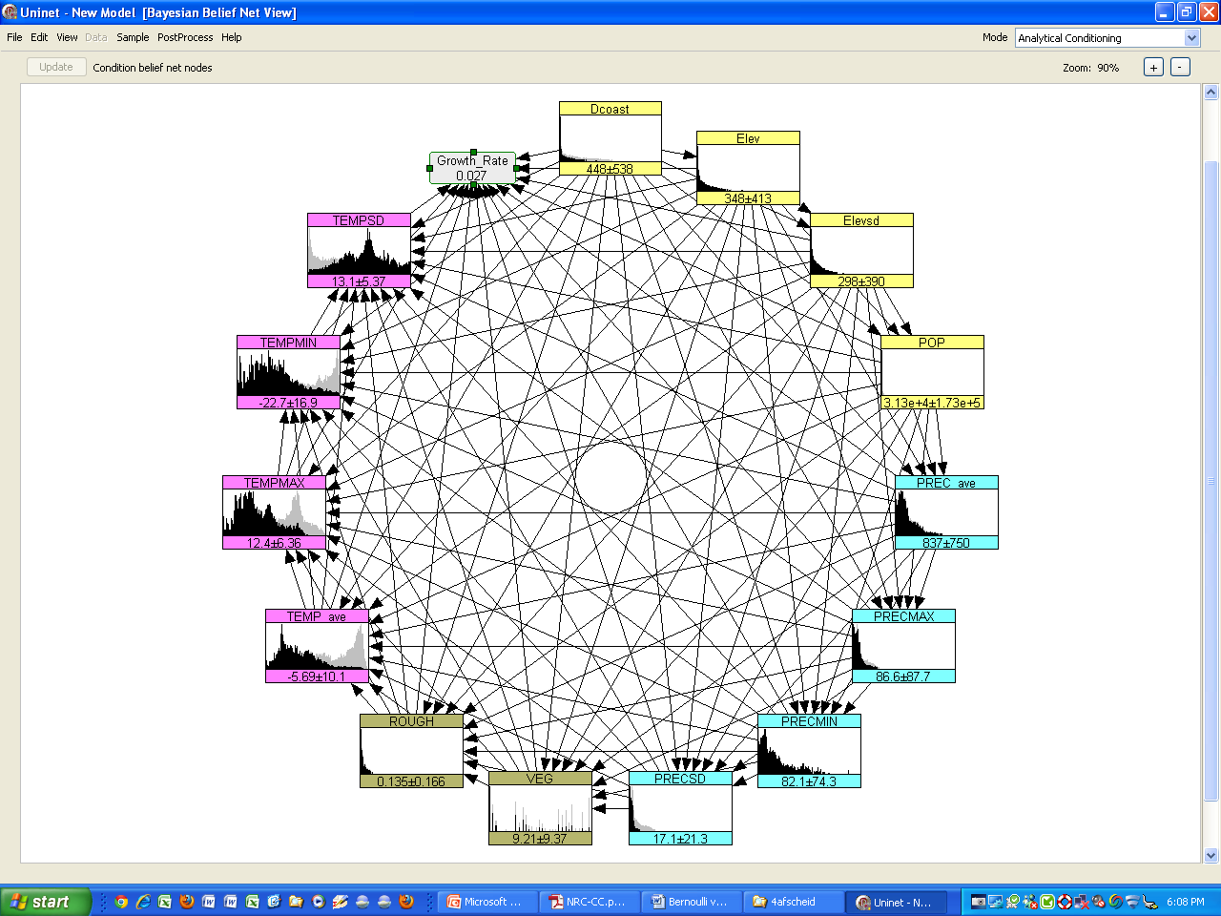

Slide 29
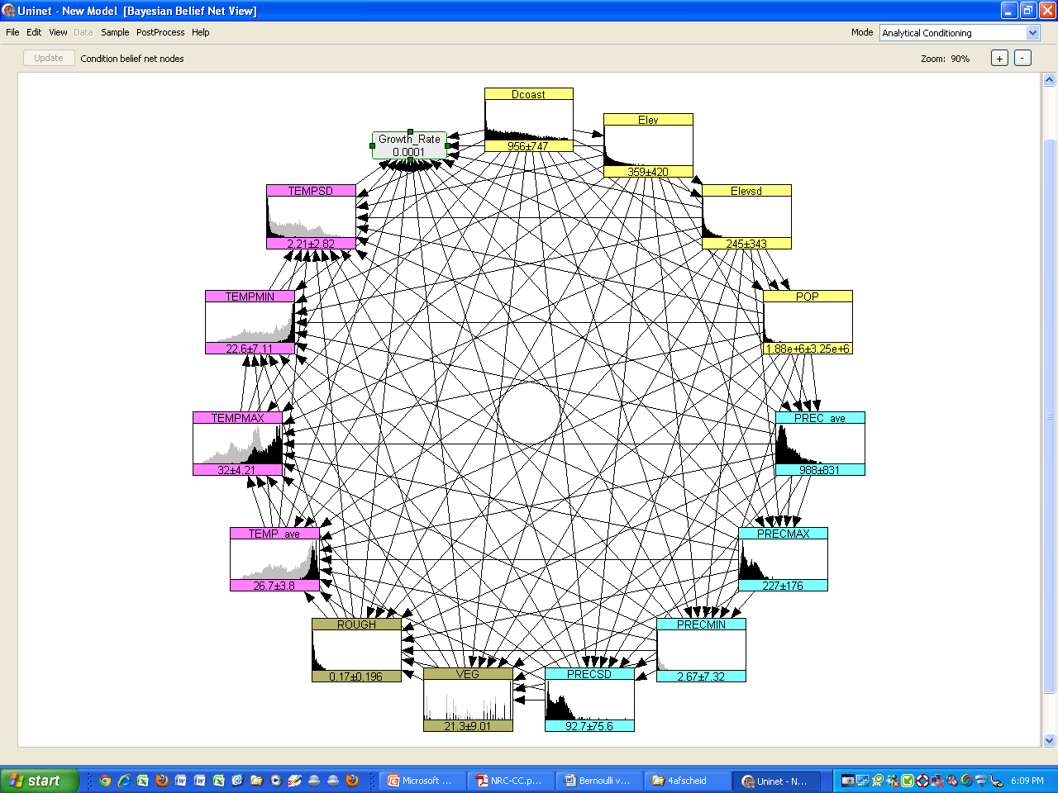

Slide 30
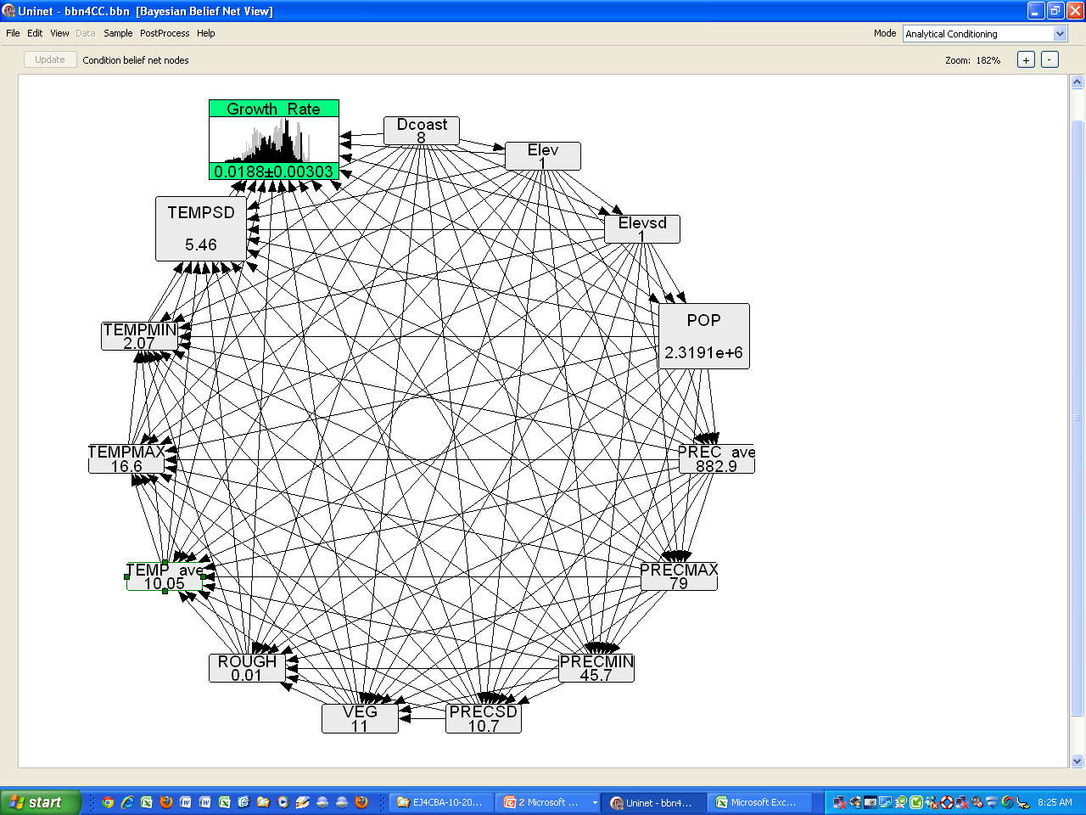
Conditionalize on Amsterdam (growth rate = 0.0218)

Slide 31
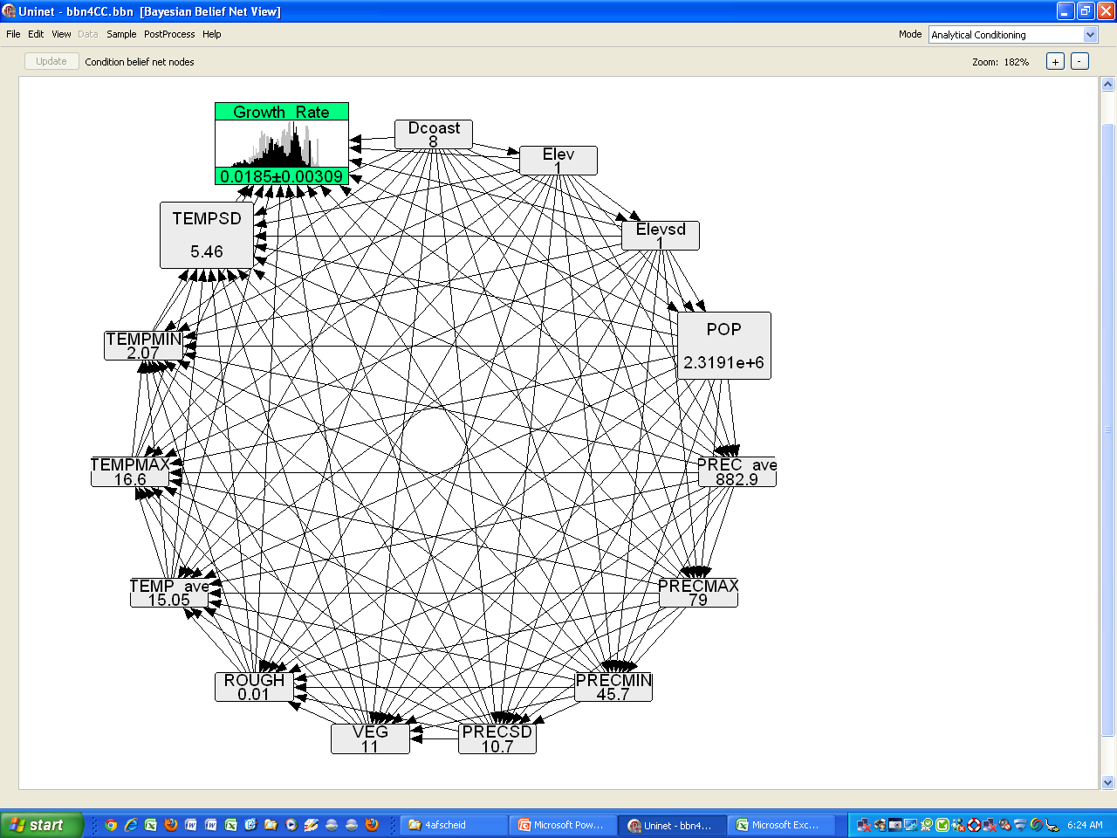
Conditionalize Amsterdam, TempAv + 5

Slide 32
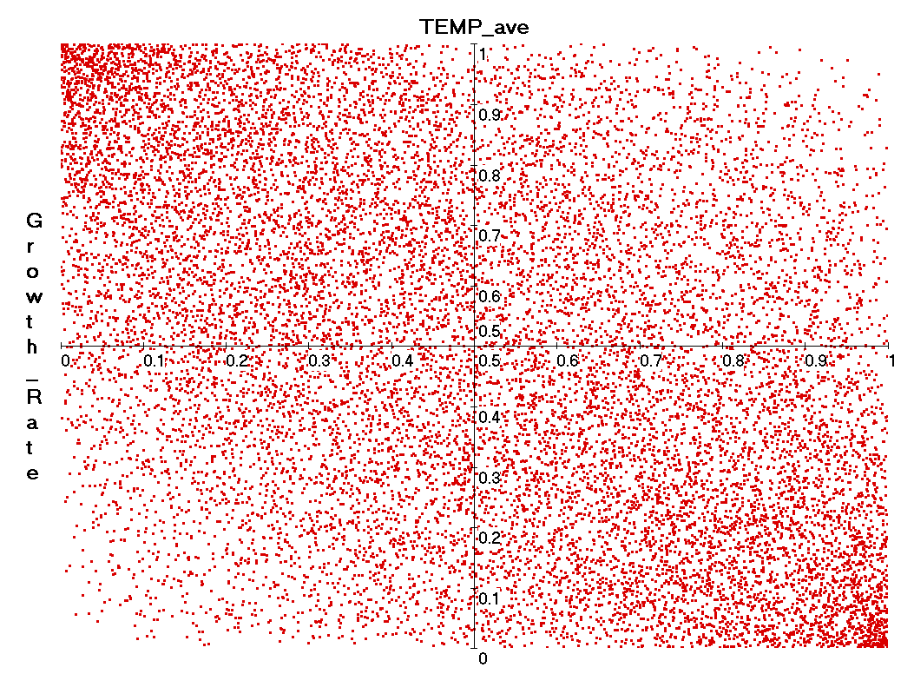
Normal Copula not good enough:

Slide 33
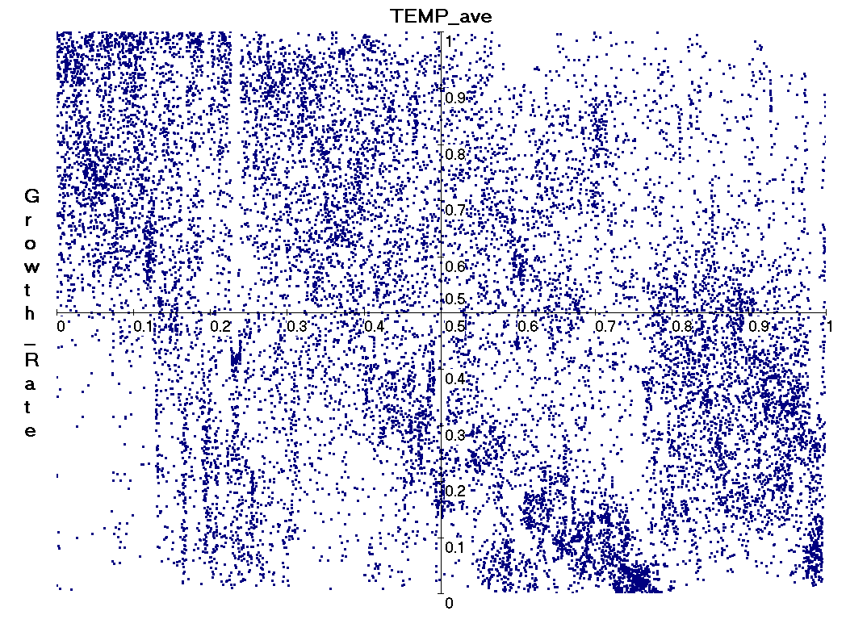
Empirical copula

Slide 34
Bernstein Copulae (Kurowicka)

Slide 36
Who pays for Uncertainty?
Mitt Romney: “My view is that we don’t know what’s causing climate change…and the idea of spending trillions and trillions of dollars to try to reduce CO2 emissions is not the right course for us”
If emissions DO cause climate change?
après nous le déluge

Slide 37
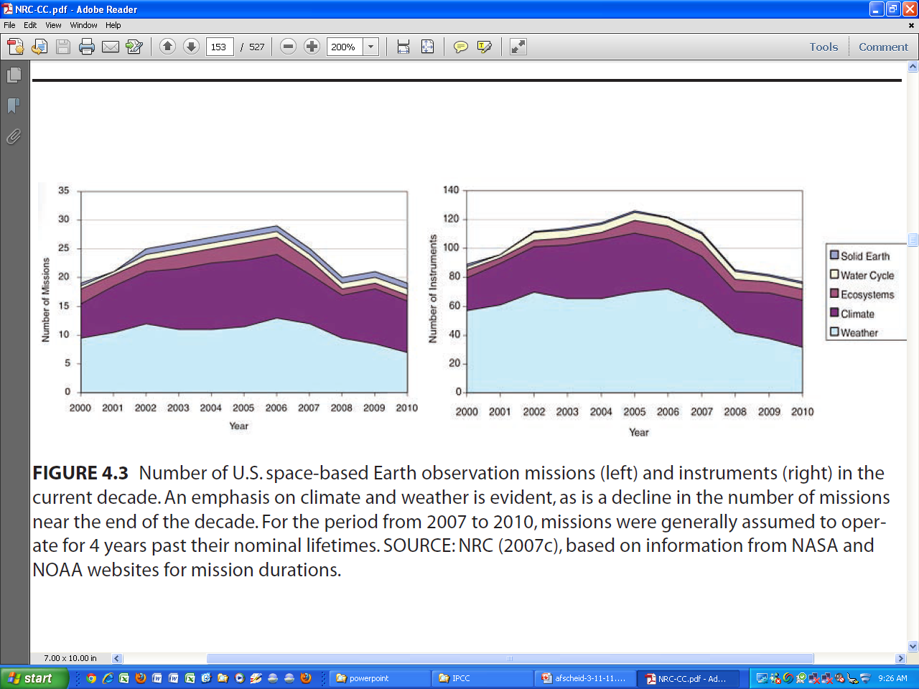
Funding cuts in Earth observation

Slide 38
We’re not taking climate uncertainty seriously
Model inter comparisons dodge uncertainty
Ambiguity dodges uncertainty
Uncertainty is a fig leaf for indecision
        But……
Not everyone is uncertain

Slide 39
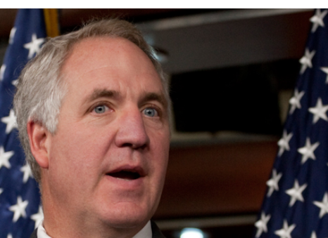
Conclusions
“I do believe in the Bible as the final word of God and I do believe that God said the Earth would not be destroyed by a flood”
John Shimkus: http://www.politico.com/news/stories/1110/44958.html
The Illinois Republican running for the powerful perch atop the House Energy and Commerce Committee told POLITICO:
D’après moi, point de déluge

Slide 40
Take Home Messages
UNCERTAINTY
AMBIGUITY
INDECISION

Slide 41
Thanks for attention & Questions

Slide 42
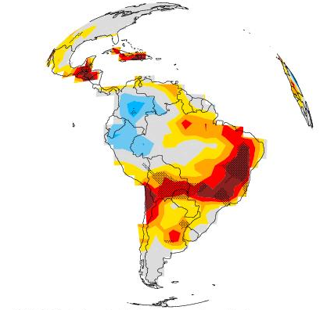
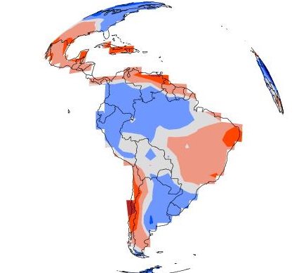
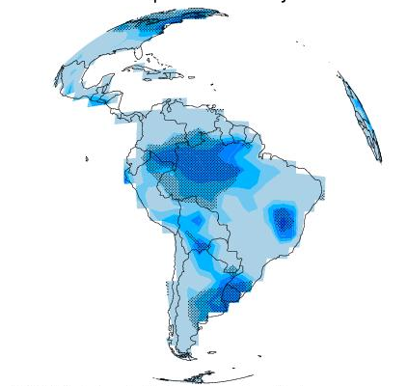
Pricing Carbon at the Margin (bau)
Assume values of climate variables
Compute path
Compute NPV of damages from Δ1 t C
Different damage model
Different SOW
Warming
GET distribution over marginal cost of carbon
Year

Slide 43
Buying Down Risk
Downside Risk
Warming
Year

Slide 44
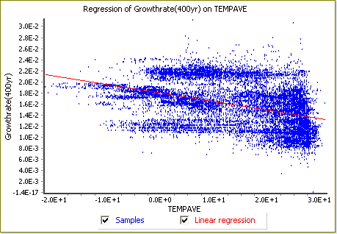
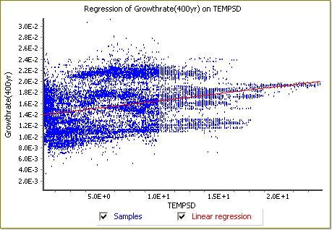
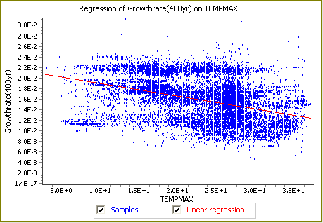
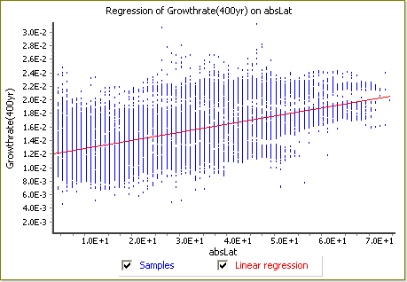

Slide 49
