Slide 1
MATLAB Tutorial II
Power Electronics and Simulink

Slide 2
Simulink Basics
Used for simulation of dynamic models (via a graphical interface).
It allows us to analyse: linear, nonlinear, time- continuous (and/ or discrete) models with multiple inputs and outputs.
Simulink works as a extension of MATLAB (retaining its funcionality while offering various qualities of dynamic systems).
It uses a block-diagram window as its main graphical interface.

Slide 3
Basic Principle of Use
Forming a simulation model
Model analysis
(Simulation)
In practice, you will implement both stages iteratively until you reach your intended goal. Each new model should be based on a pre-existing one (no need to start from scratch)

Slide 4
Simulink Extensions
Various software and hardware devices can be used with Simulink.
These extensions usually represent additional libraries, special compilers and/ or hardware extensions.
This greatly increases the ease with which one can program various codes, run and monitor complex systems and develop experimental setups.

Slide 5
Creating a Model
By using blocks – (simple ?)
Similar to making block-diagrams
Blocks:
Are copied from libraries and connected manually.
Contain parameters that can be fixed or changed.
Some parameters can be changed during simulations.
Two main types of block libraries:
Standard, Simulink lib.
User-defined lib.

Slide 6
Creating a Model
A model is created by a drag-and-drop technique from a specific library to the workspace.
The connection lines represent mathematical relations and determine the data flow.
One can edit the model via operations like: copy, past, undo, align, distribute, resize.
Please try to keep your models as organized and intuitive as possible. Others (and even you) can easily get lost in more complex systems.
Group your blocks in subsystems (more on them later), name your variables accordingly and use signal routing blocks in order to avoid unnecessary lines.

Slide 7
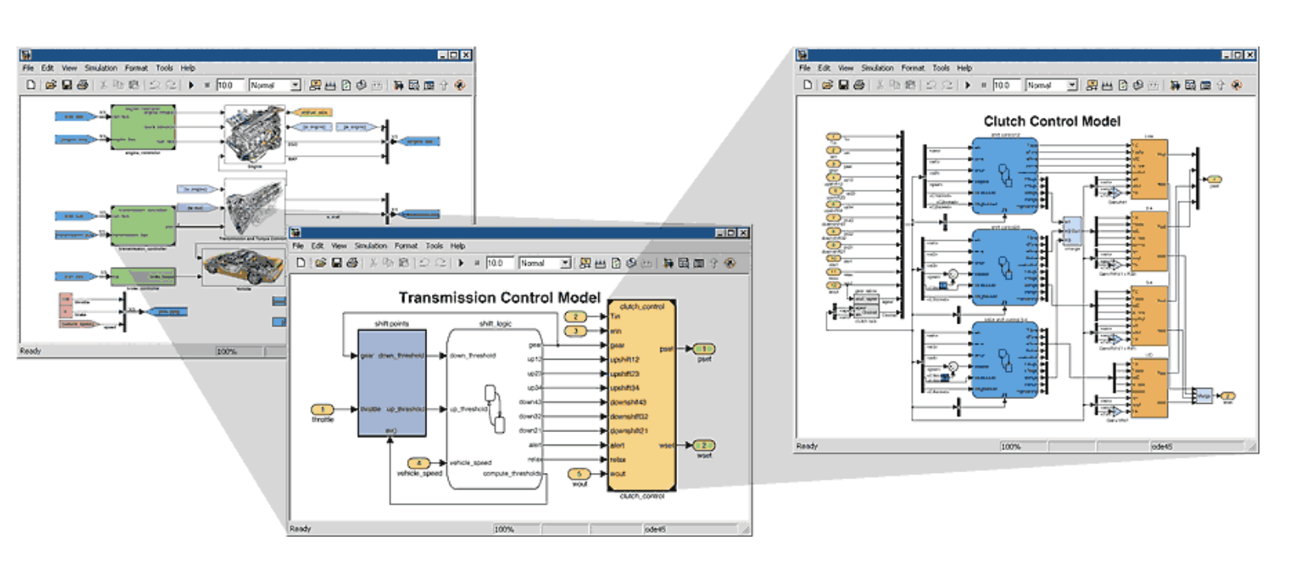
Model Hierarchy
Example 1: Simulink model of a automobile with several levels of modeling

Slide 8
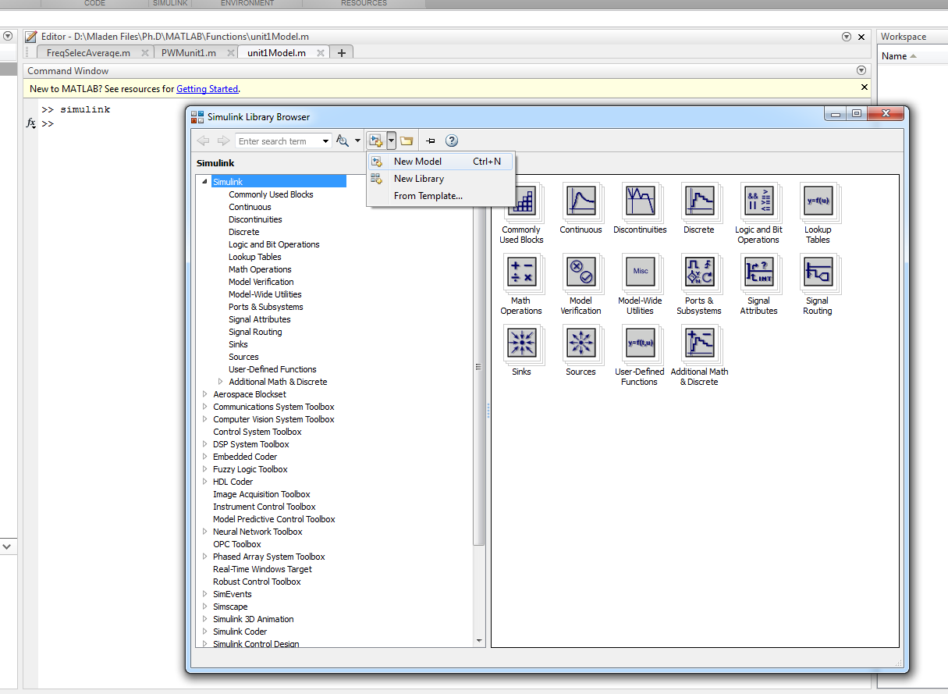
Lets Get Started
To initiate Simulink, simply type “simulink”in your MATLAB command window.

Slide 9
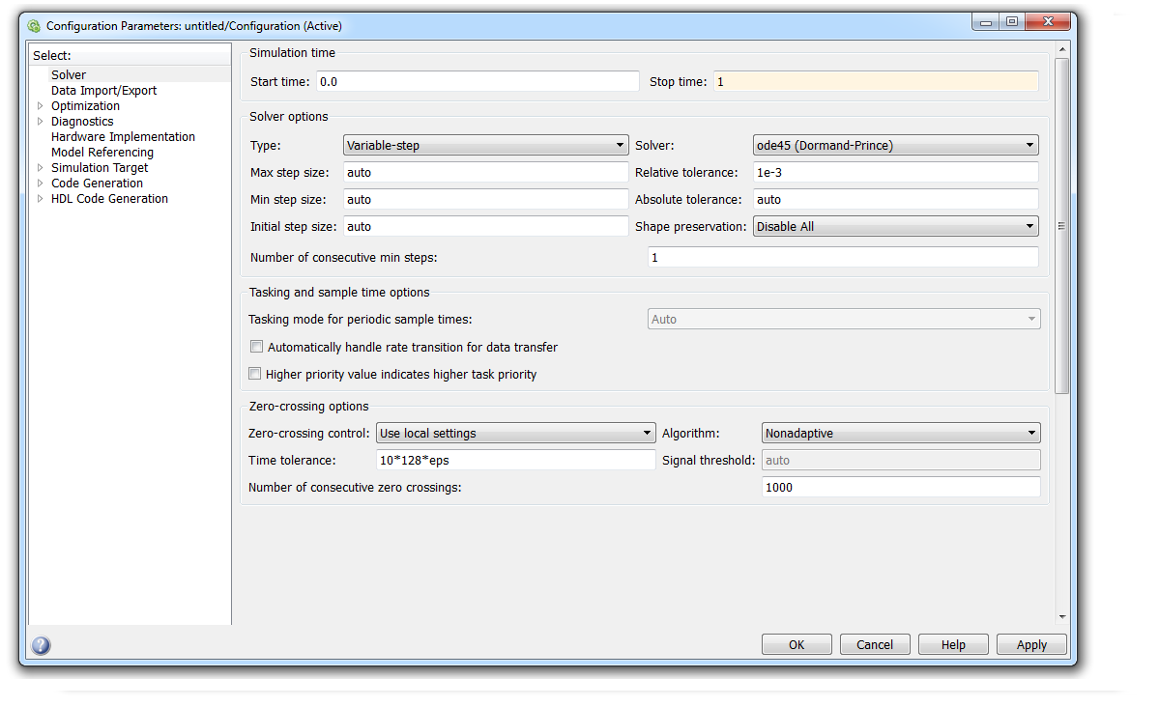
Setting-up the Model
Before you begin, do not forget to save the model in a separate folder.
Afterword, configure the model as such:
1
3
2

Slide 10
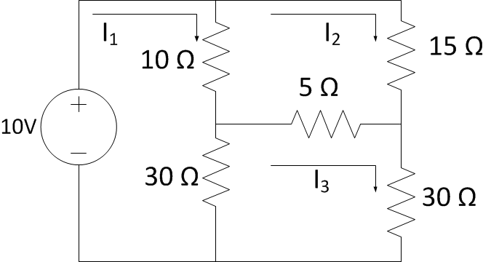
Start drawing
First assignment- from yesterday: basic circuit.
What do we need ?
- Resistors
- DC voltage source
- Some way to measure currents and voltages

Slide 11
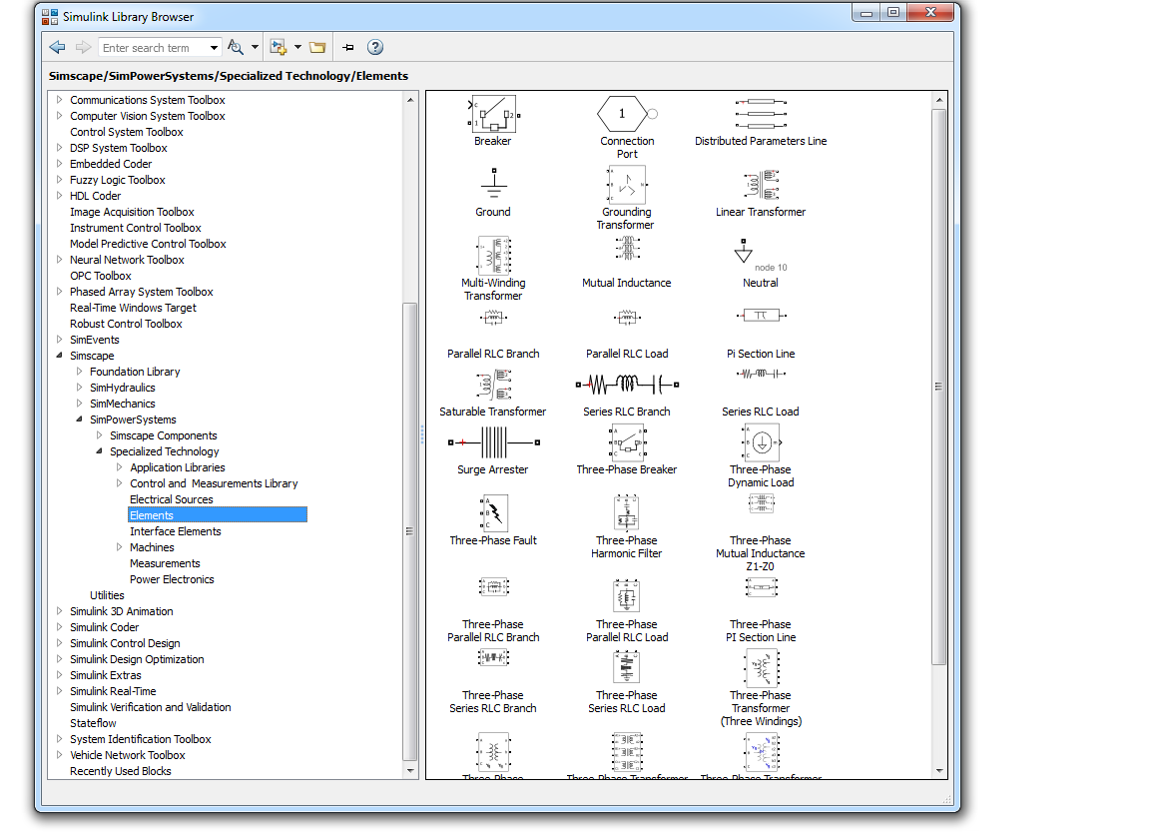
Library
Since this tutorial is mostly focused on power electronics, our main library will be SimPowerSystems
Second very important group of libraries

Slide 12
Useful Tips for Modeling
Place all different element from the library to the workspace first.
Change the names and parameters of the first blocks to something that can be easily edited later.
Right-click and drag the block to copy them.
Hold ctrl and to connect two blocks.
Press ctrl+R to rotate the blocks.
Hide the names of generic blocks like math functions or some signal routing elements.

Slide 13
Important when working with PE !
You need a powergui block
The simplest way of finding it is by searching for it in the library.
We will discuss more about it later.

Slide 14
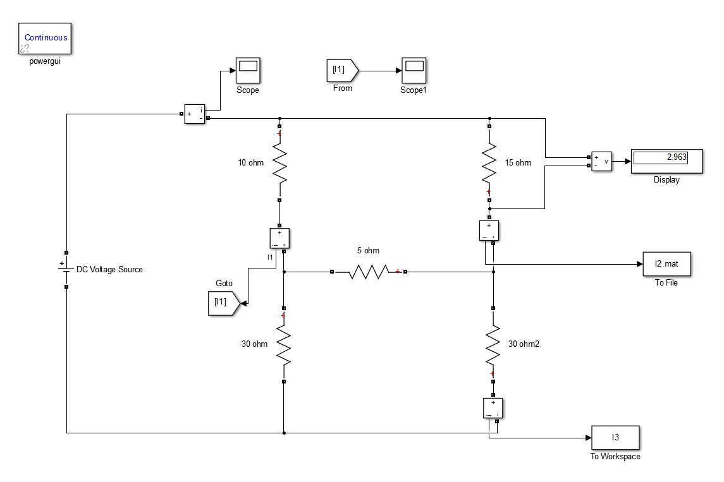
Measurements
There are multiple ways in which we can measure different values in our models.

Slide 15
Important for Scopes
Remove the data limit as soon as you copy the first scope to your workspace

Slide 16
Extracting Data from the Simulation
From file:
In the block, specify to save the format as array
To workspace
In the block, specify to save the format as structure with time

Slide 17
Using PE Devices- Uncontrolled Rectifier
Where are the diodes hidden in SimPowerSystem ?
- Start with a diode bridge, AC voltage source and a 100 ohm resistor.
- Measure all relevant values.

Slide 18
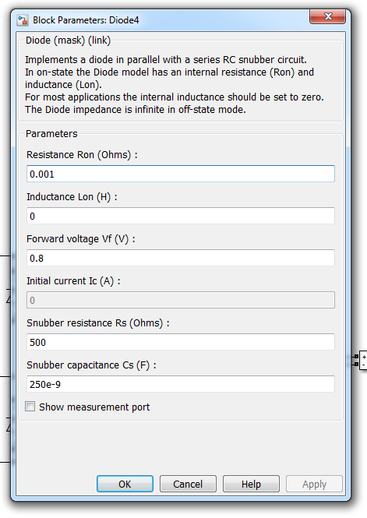
Diode Parameters
Keep the values od the diode parameters as-is.
Run the simulation, what do you notice?
Add a capacitor in parallel with the resistance- now what happens ?
Simulation time ?
Initial current ?

Slide 19
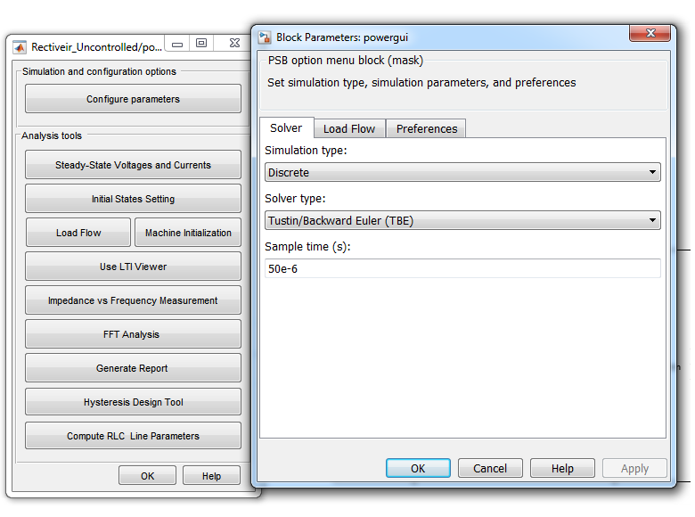
Time to Save Time and Switch the Switches in Digital
Or in this case the diodes, and the simulation, to be more precise, in fixed-step (discrete).
Modify the powergui and configuration parameters as such:

Slide 20
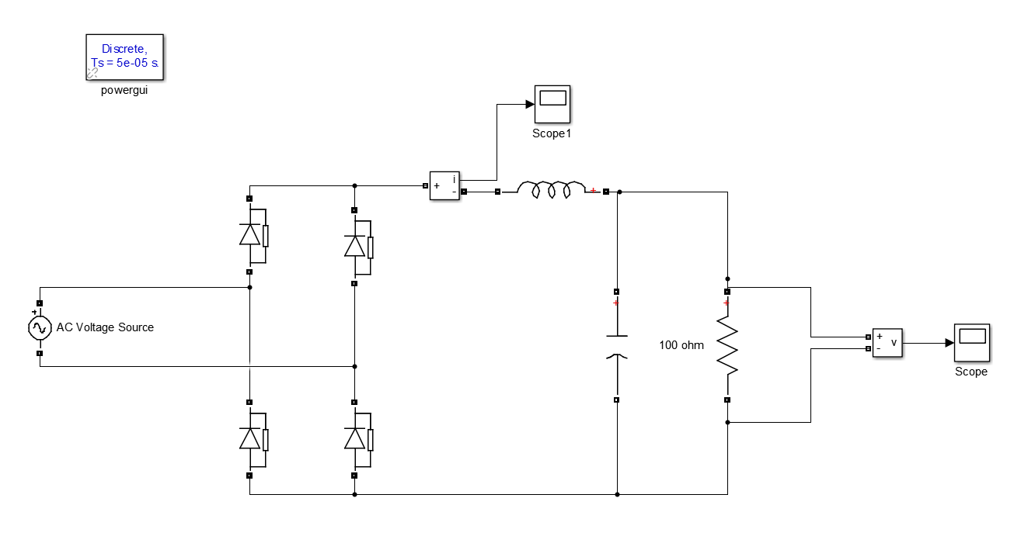
Finalising the Rectifier
Add an inductor in series with the load and capacitor.
What happens to the initial current ?

Slide 21
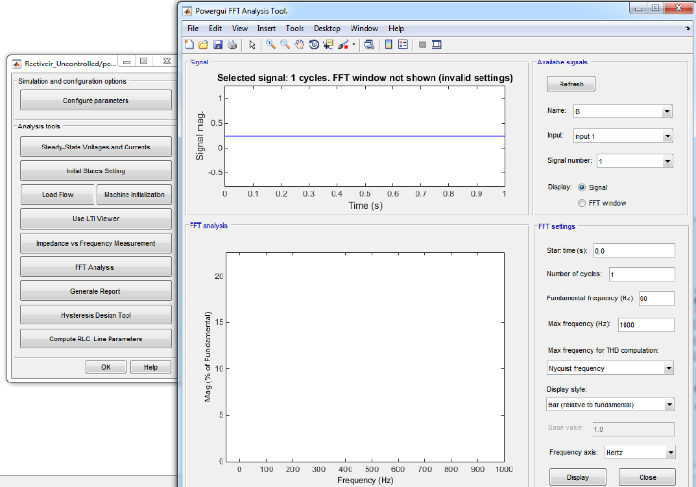
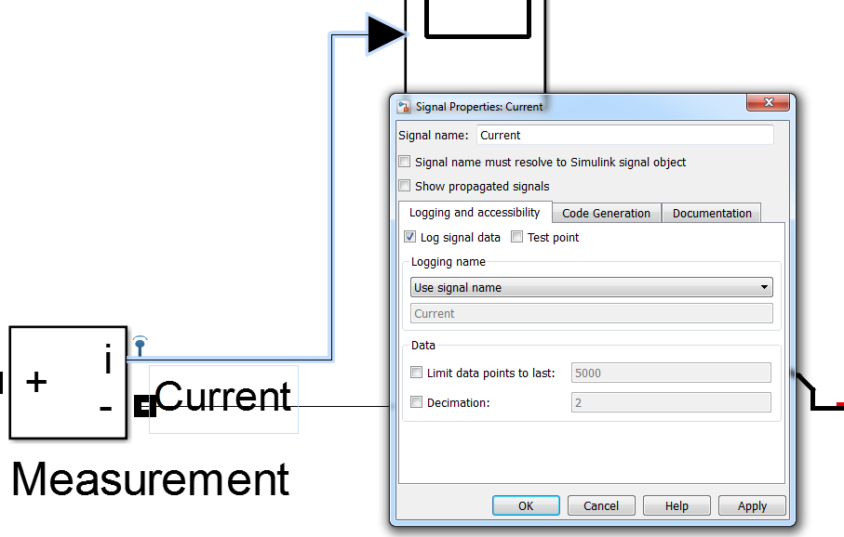
Analysing the Harmonics
In the case of PE converters or various electrical systems, there is a great focus on evaluating the THD and harmonic spectre of electrical parameters.
To achieve this in Simulink, we specify the values variables of interest and analyse them via the powergui block.
To assign a signal that you wish to analyse, right-click on the line and chose properties. Then, set the options as such:

Slide 22
Analysing the Harmonics
To assign a signal that you wish to analyse, right-click on the line and chose properties. Then, set the options as such:
Run the simulation, experiment with different parameter values and se how the THD changes.

Slide 23
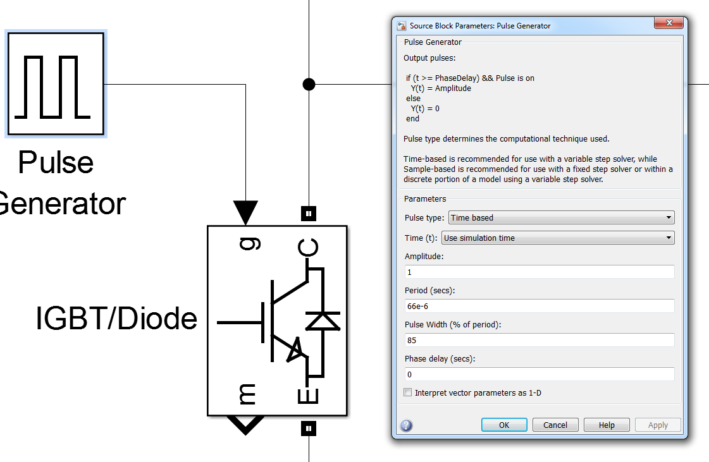
Time to Switch to a More Controllable Device and Boost our Understanding
In order to function properly, PE switches require signals that determine there state (on/off) and modulates the output signal.
In Simulink, this signal represents a logical (1 or 0) value that we bring to the gate terminal of the block.
The most simple form of modulation is a fixed duty-cycle periodic signal that can easily be achieved via the Pulse Generator block
Make sure that your simulation period is in sync with your switching period

Slide 24
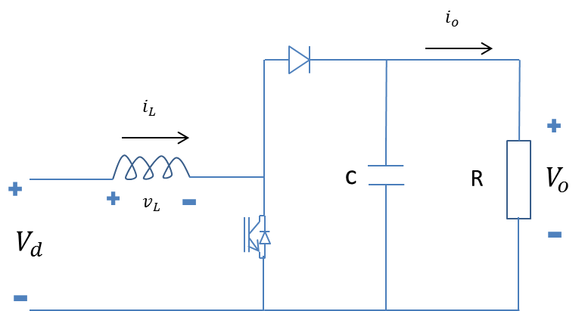
Your task:
Construct a Boost converter with one of the two main types of switches and their respective parameters:
D | 0,7
f | 80kHz
Vd | 45V
Vo | 150V
R | 400 ohm
L | 0,787mH
C | 3,3uF
Δi | 20%
MOSFET version
D | 0,85
f | 15kHz
Vd | 45V
Vo | 300V
R | 400 ohm
L | 1,02mH
C | 3,3uF
Δi | 20%
IGBT version

Slide 25
Results ?
If you are done, try to make a Buck or Buck-Boost converter using these blocks.

Slide 26
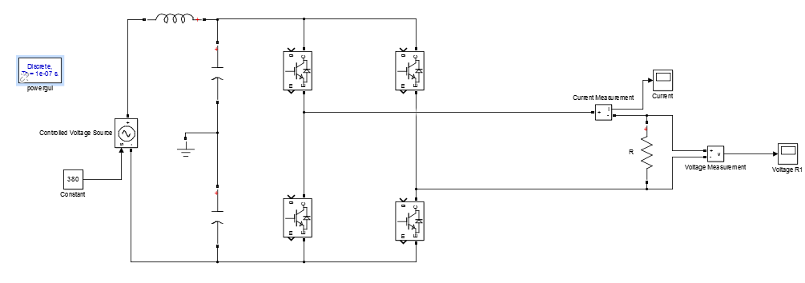
Single Phase Inverter
In order to operate a full-bridge converter we need to implement a variable duty-cycle PWM.
To generate this type of PWM, we need to construct a carrier and a modulation signal and compare them.
For now, construct a FB inverter using IGBTs blocks, a controlled voltage source on the DC bus and a 100 ohm resistor on the output.

Slide 27
PWM Signal
The PWM generator, as previously stated need to provide the neccesary type of signal to the gates of the switches.
One way to construct it using block is as followed:

Slide 28
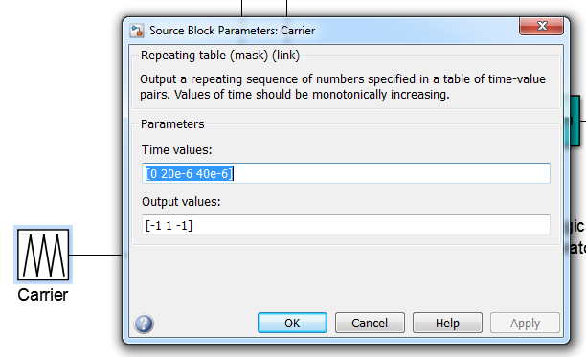
PWM Signal
The carrier signal in this case is a triangular periodic signal with the following parameters:
The modulation signal can also be changed by adjusting the parameters in the blocks.
Connect these signals to the respective gates and run the simulation.

Slide 29
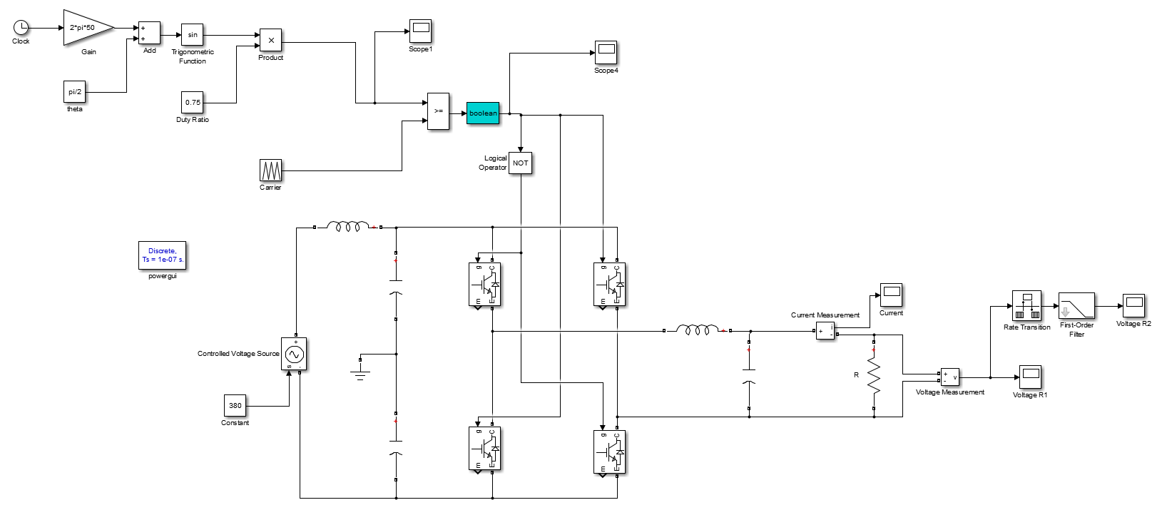
Harmonic Filtering
How does the voltage/ current of the output look ?
Measure the THD of these signals like we did in the previous examples.
Add an output filter using a inductor and capacitor choose there values in order to mitigate the THD.

Slide 30
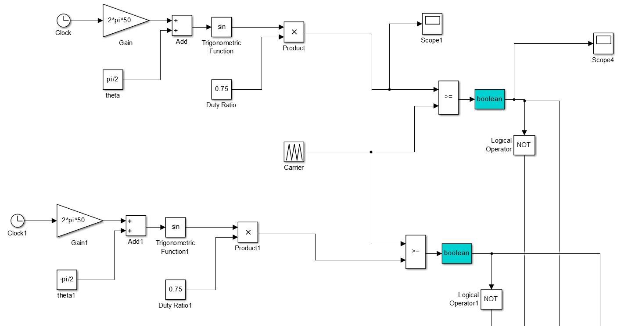
Unipolar Modulation
Modify the model to operate with a unipolar PWM.
What is the difference in THD in comparison with bipolar modulation ?
The odd carrier and associated sideband harmonic are eliminated

Slide 31
That Concludes this Tutorial
Thank you for your attention and good luck with your master studies

