Slide 1
How to approach a top-down call topic in Horizon 2020?

Slide 2
Topic text structure
Header
Specific challenge
Scope
Expected impact

Slide 3
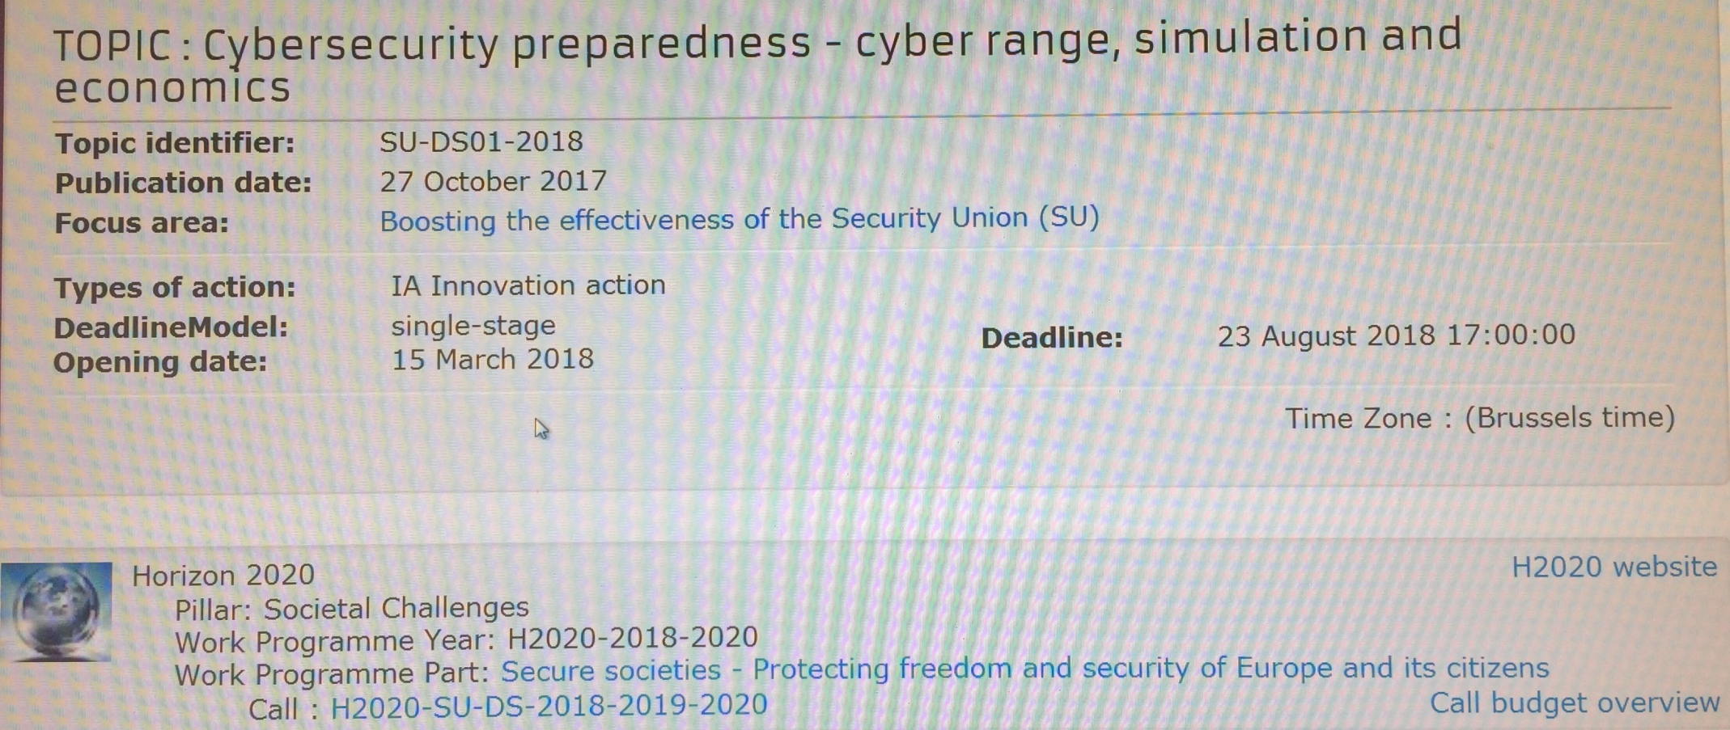
Cybersecurity preparedness - cyber range, simulation and economics
SU-DS01-2018
Title
Dates
Type
Deadline model
Work programme
Call budget

Slide 4
Specific challenge:
digital infrastructure: resilient, trustworthy, secure
new technologies require
innovative security measures
new security-related assumptions
identifying potential unknown vulnerabilities
forecasting new threats, managing cyber risks
adapt expertise
novel cyber-attacks,
ICT systems and services omni-present
changing legislation
urgent need
cybersecurity professionals
constant learning process
advance cybersecurity skills at all levels

Slide 5
Scope:
Develop and validate customizable dynamic simulators
shared approaches
transform user needs into experiments and exercises
develop tools and methods for supporting simulation scenarios
validated cyber range model across one critical economic sector
include public security end-users and/or private end-users
link to Computer Emergency Response Teams (CERTs) / Computer Security Incident Response Teams (CSIRTs)

Slide 6
Scope:
analyse information from CERTs and/or CSIRTs
econometric models
solutions for specific social aspects of digital security related to practical, operational and hands-on training

Slide 7
Scope:
Involve SMEs
Bring technology to TRL 7
Expected budget request: 5 to 6 M€
General: 4.5 < budget < 6.6
Available for this topic: 16 M€
Expected impacts & objectives >> concept & methodology >> work packages >> tasks >> person months & other costs >> add
Re-iterate!
Innovation Action:
100 % direct costs for TUD, 70 % for profit partners
Technology readiness level
3: Proof of concept
6: technology demonstrated in relevant environment
7: pilot
8: system complete and qualified

Slide 8
Expected impact:
Short-term:
Prepare professionals better for cyber-attacks;
cybersecurity end-users share needs with developers/vendors;
More organized collaboration;
Use of improved risks analysis models;
Appropriate econometric models;
Improve organisations’ investments against cyber-attacks.

Slide 9
Expected impact:
Medium and long term:
Improved ICT resilience and cost reduction for training users;
prepare for malware campaigns and malicious infrastructures;
improved EU-skills market;
preparedness for cybersecurity measures;
resources identification for cyber-attack recovery;
Improved security, resilience and sustainability of organisations.

Slide 10
Next steps:
Background literature
One-pager
Consortium
Proposal

Slide 11
European Union Agency for Network and Information Security:
Resilience and security of communication infrastructure, networks and services
European Cyber Security Organization:
European Cybersecurity Strategic Research and Innovation Agenda for a Contractual Public Private Partnership

Slide 12
Competitiveness
Prosperity
Well-being
PhD positions
Capacity building
Collaboration

Slide 13
EU Research Funding Team
Servaas Duterloo
s.b.duterloo@
Jan Schiereck
j.d.schiereck@
Daphne van de Sande
d.vandesande@
David Sayago
d.i.sayagohilera@
Fleur Vermulen-Duijndam
f.j.vermeulen-duijndam@
Trudy van Nieuwkoop
g.h.vannieuwkoop@
Subsidy-VC@tudelft.nl

