Slide 1
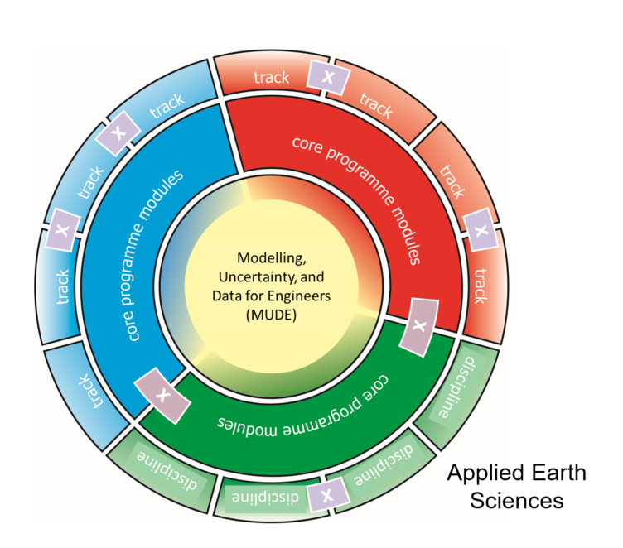
MSc Applied Earth Sciences Information for third-year bachelor students Room C

Slide 2
General introduction, MUDE and Cross-overs: Before we start…
The general introduction about all three new MSc programmes at CEG is presented in room A. This is also streamed to rooms B, C and D.
You can ask your questions after the presentation.
Students watching from home can ask their questions in the Teams chat (Teams link in invitation). Please turn off your camera and microphone in this Teams meeting.
All sessions are recorded. Recordings will be made available on portal and Brightspace.

Slide 3
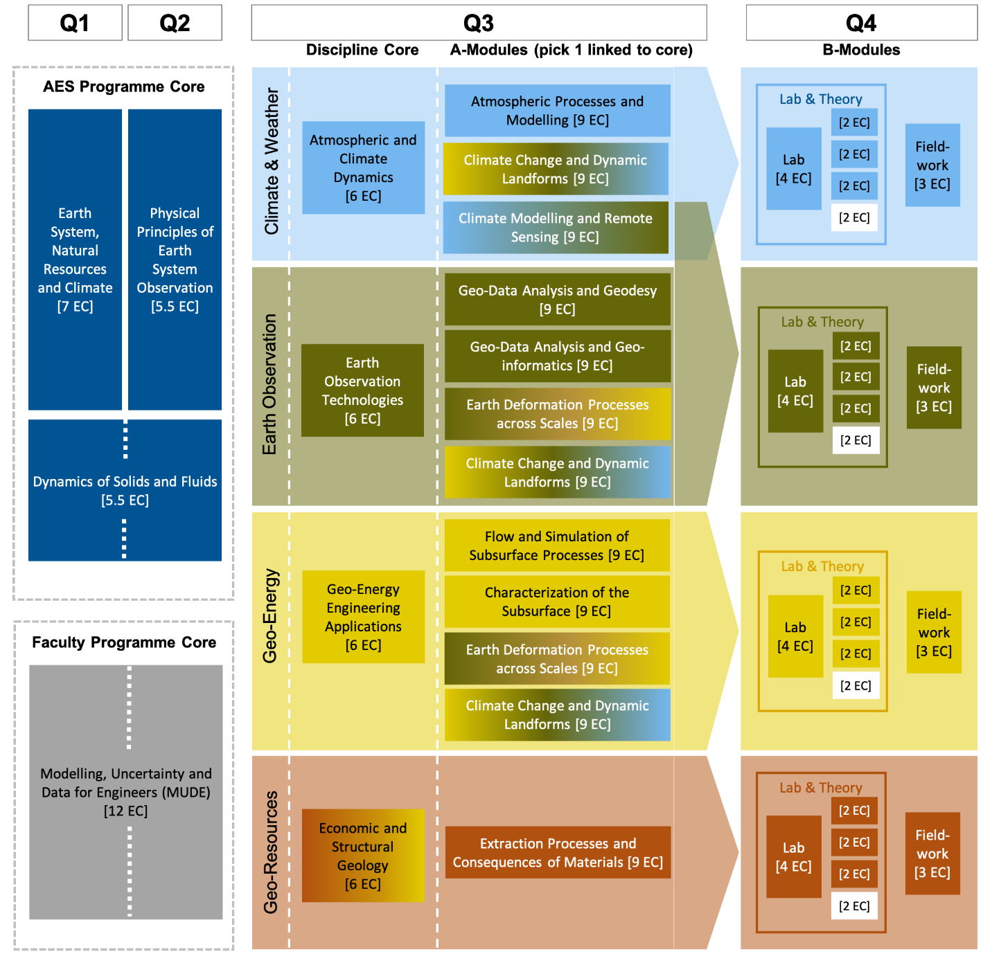
Overview programme MSc AES
Year 1

Slide 4
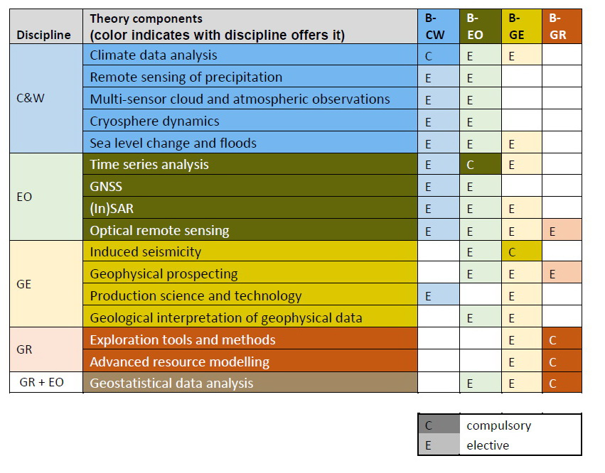
Overview programme MSc AES
Year 1 Q4: B-modules Theory units

Slide 5
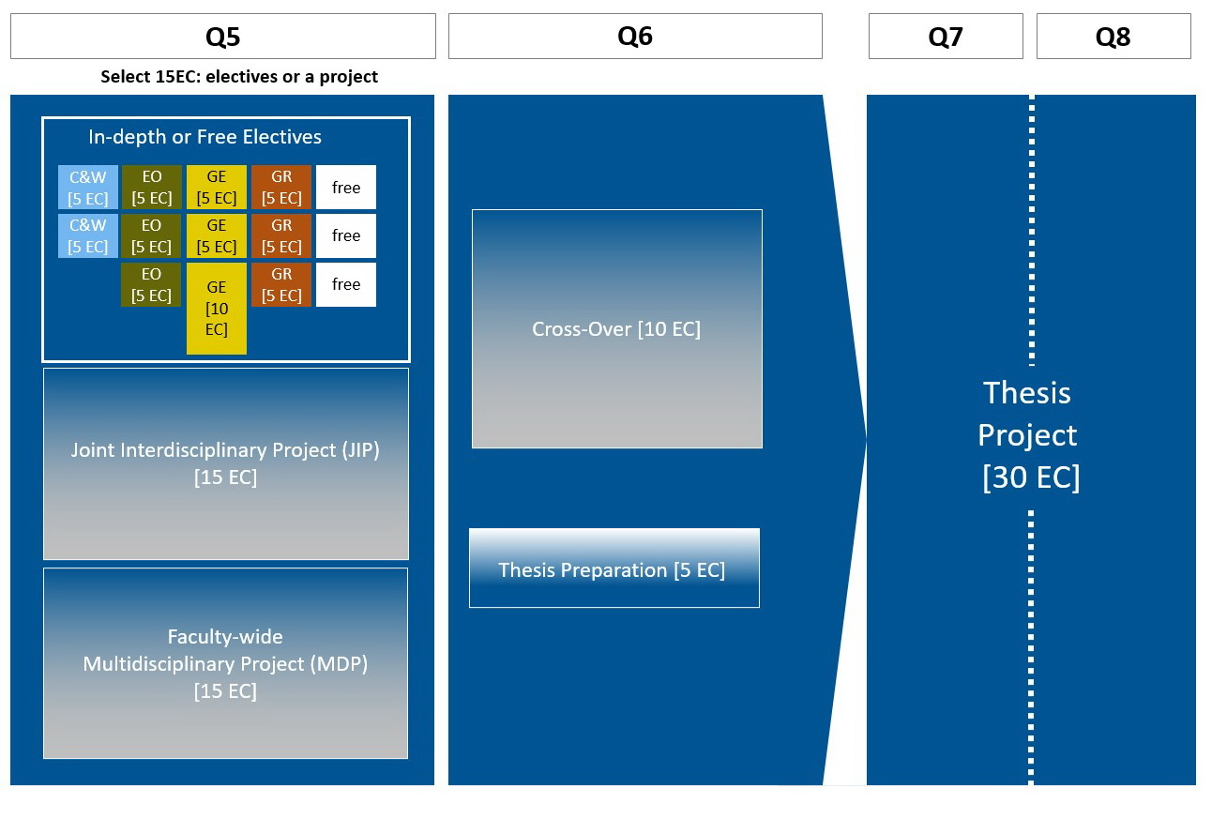
Overview programme MSc AES
Year 2

Slide 6
Possibilities and choices to make in programme MSc AES
For Q3:
which discipline core?
Which A-module?
For Q4:
Which B-module and which units?
For Q5:
JIP, MDP or (which) electives?
For Q6:
Which cross-over?
Which thesis subject?

Slide 7
Preparations for MSc AES
Students with AES BSc are well prepared
Students with other TU Delft BSc may want to study Geology (e.g. MOOC)
Students with Earth Science BSc may want to take additional Math & Physics

Slide 8
Information
Study advisors
Director of studies Drs. J. K. Blom
Student portal, FAQ
Website https://www.tudelft.nl/onderwijs/opleidingen/masters/aes/msc-applied-earth-sciences

Slide 9
Joint MSc Applied Geophysics Information for third-year bachelor students

Slide 10
Overview programme Joint MSc AGP
Q1 & Q2 (Delft)
Q3 & Q4 (Zürich)
Year 1
AGP Core Modules
(3 out of 3)
AGP Core Modules
(3 out of 3)
AGP Core Modules
(3 out of 3)
AGP Core Modules
(3 out of 3)
Field Geophysics and Signal Analysis with Exercises
[6 EC]
Reflection Seismology Processing
[5 EC]
Advanced reflection seismology and seismic imaging
[6 EC]
Geophysical Fieldwork and Processing
[9 EC]
Modelling and Inverse Theory for Applied Geophysics
[8 EC]
Electromagnetic exploration methods [6 EC]
Suggested Electives
Suggested Electives
Geofluids
[6 EC]
Seismic Acquisition to Data Information Content
[6 EC]
Geothermal Energy
[3 EC]
Geophysics special subjects
[6 EC]
Inverse Theory II: Applications
[3 EC]
Any courses from the MSc AES, EE, CE
Mathematics V: Applied Deepening of Mathematics I – III
[3 EC]

Slide 11
Overview programme Joint MSc AGP
Q5 & Q6 (Aachen)
Q7 & Q8 (Delft/Zürich/Aachen)
Year 2
AGP Core Modules
(3 out of 6)
AGP Core Modules
(3 out of 6)
Research module in applied geophysics [6 EC]
Thesis Project
[30 EC]
Petrophysics for Applied Geophysics [6 EC]
Geophysical Logging and Log Interpretation [6 EC]
Application of Geophysical Prospecting Methods in Earth and Environmental Science [6 EC]
Hydrogeophysics and Engineering Geophysics [6 EC]
Numerical Reservoir Engineering + Advanced Mathematical Modelling in Applied Geosciences [6 EC]
Suggested Electives
Data analysis in Geoscience, Mineral exploration, Petroleum system modelling, Sedimentary basin dynamics, Remote sensing of sedimentary basins, Portfolio management and prospect evaluation, Energy resource management, Principles of plate tectonics, Plate tectonics seminar, Numerical Methods for Geophysical Flows, Neotectonics and Earthquake Geology
[3 EC each]
Finite elements in fluids, Economics of technological diffusion, Machine learning, Underground excavation
[6 EC each]

Slide 12
Preparations for Joint MSc AGP
Students with AES BSc are well prepared
Students with other TU Delft BSc may want to study Geology (e.g. MOOC)
Students with Earth Science BSc may want to take additional Math & Physics

Slide 13
Information MSC AES
Studyadvisors
Student portal MSc AES
Website MSc AES

