Slide 1
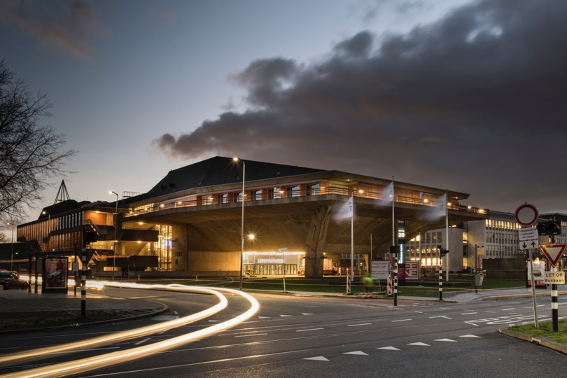
Corporate presentation

Slide 2
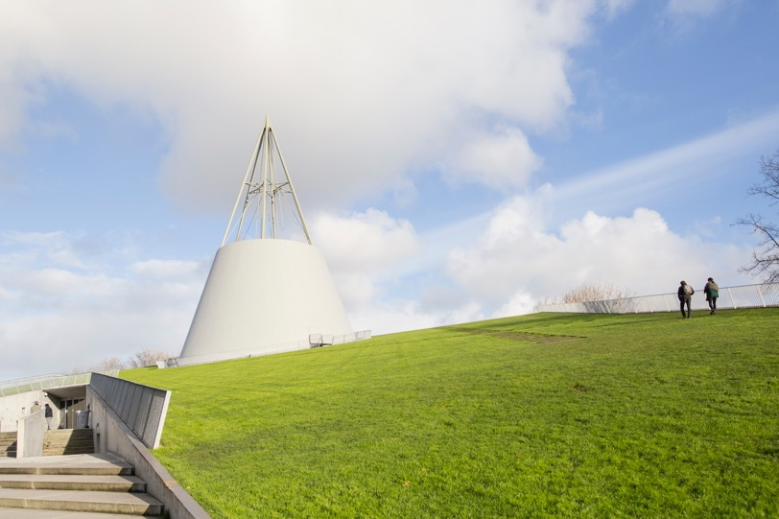
Education
History
Our…
Institutes
Research
Students
Facilities
Alumni
Organisation

Slide 3
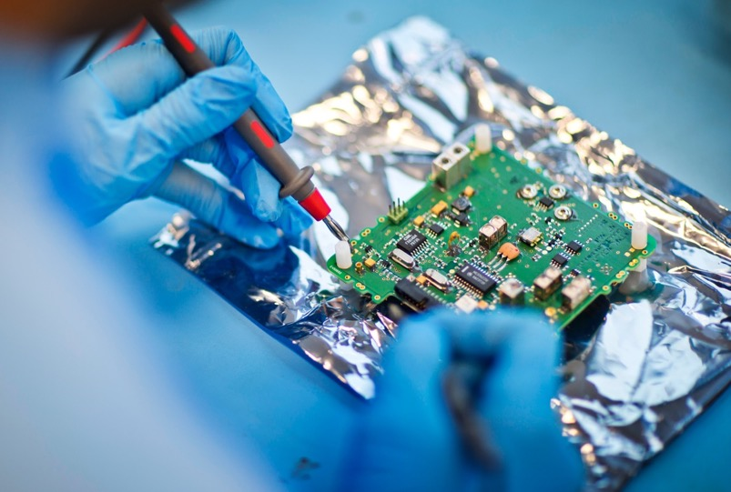
Portrait

Slide 4
Vision
TU Delft believes its role in society is to supply technological solutions that take us significantly further along the road towards sustainability and a flourishing economy. We position ourselves as an open academic community which, through our academic staff and graduates, is represented throughout the academic world while also embedded in our own regional and national, social and economic environment.

Slide 5
Mission
TU Delft’s mission is to make a significant contribution to a sustainable society for the 21st century by conducting groundbreaking scientific and technological research – acknowledged as world class; by training scientists and engineers with a genuine commitment to society; and by helping to translate knowledge into technological innovations and activities with both economic and social value.

Slide 6
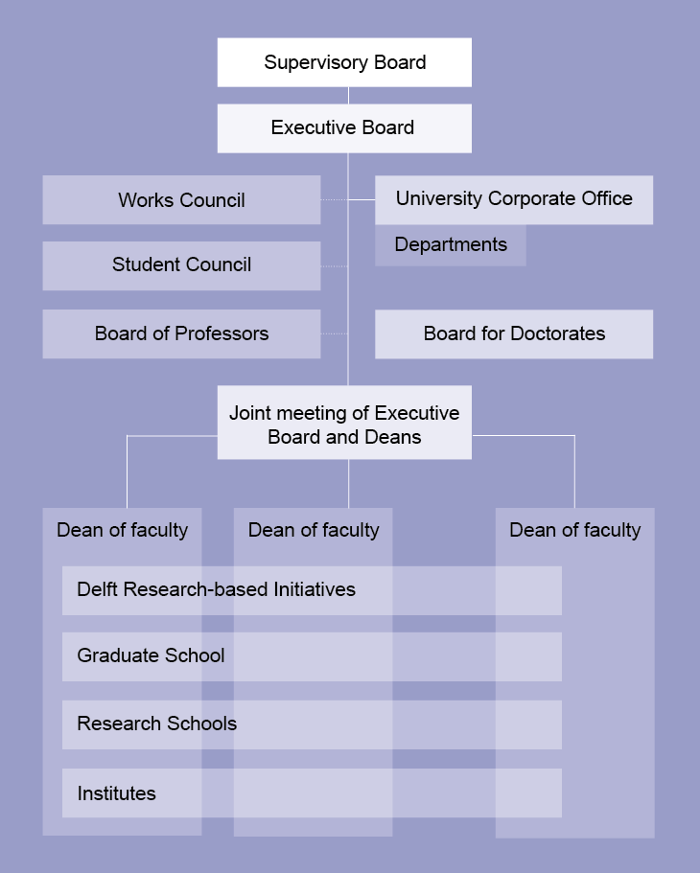

Slide 7
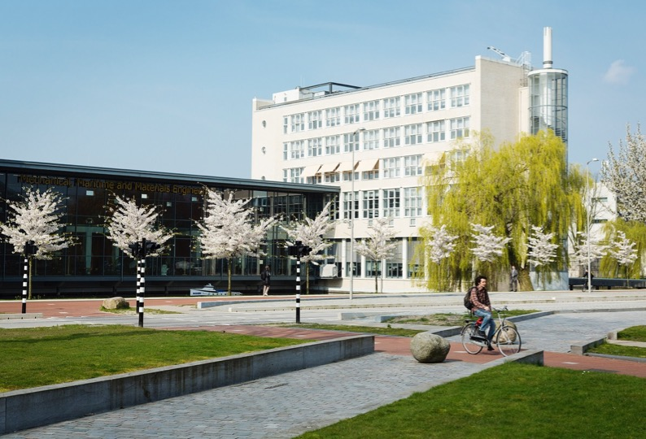
Delft University of Technology at a glance

Slide 8
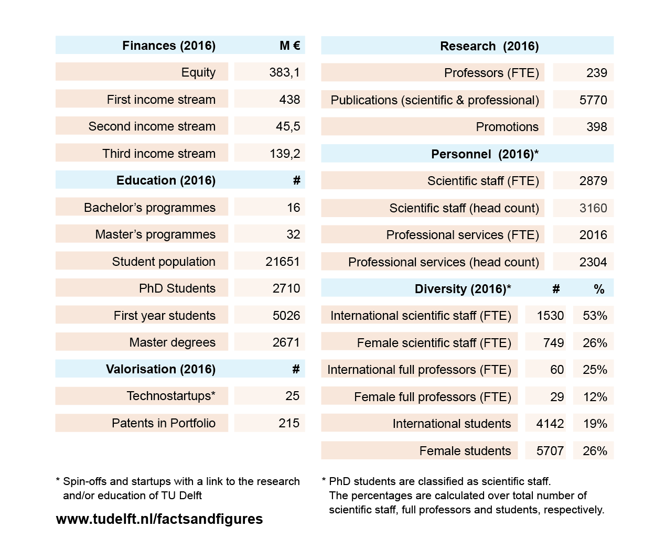

Slide 9
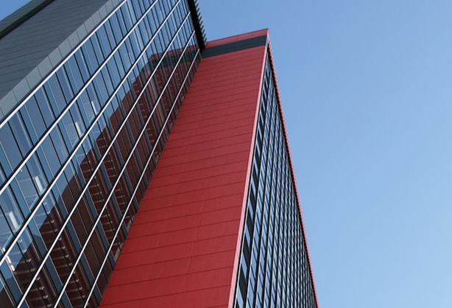
Faculties

Slide 10
Aerospace Engineering (AE)
Applied Sciences (AS)
Architecture and the Built Environment (Arch)
Civil engineering and Geosciences (CEG)
Electrical Engineering, Mathematics and Computer Science (EEMCS)
Industrial Design Engineering (IDE)
Mechanical, Maritime and Materials Engineering (3mE)
Technology, Policy and Management (TPM)

Slide 11
Education and
Students

Slide 12
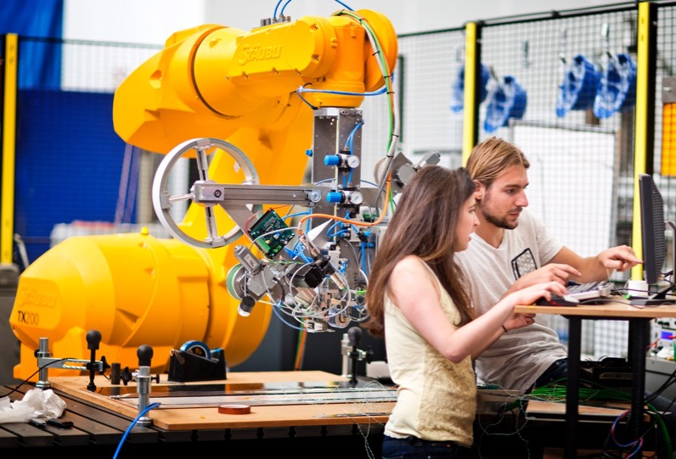
• 16 BSc programmes
• 30 MSc programmes
Notes:
• TU Delft has developed a portfolio of 16 BSc programmes (including four joint degrees), which cover the broad range of engineering disciplines.
• The University offers more than 30 MSc programmes, several of which are unique in the Netherlands.
• Some of these degree programmes are offered in conjunction with other institutions, under the auspices of either the 4TU Federation (the collaborative venture of the four Dutch universities of technology) or our alliance with Leiden University and Erasmus University Rotterdam.
• Our MSc programmes are taught in English, as are our Applied Earth Sciences, Aerospace Engineering, Computer Science and Engineering and Nanobiology BSc programmes.
• TU Delft encourages ambitious students to participate in the Honours Programme Bachelor or Master; an extra-curricular programme designed to enrich the overall study experience.

Slide 13
Bachelor’s
• Aerospace Engineering
• Applied Earth Sciences
• Applied Mathematics
• Applied Physics
• Architecture, Urbanism & Building Sciences
• Civil Engineering
• Clinical Technology (joint degree)
• Computer Science and Engineering
• Industrial Design
• Life Science and Technology (joint degree)
• Marine Technology
• Mechanical Engineering
• Molecular Science and Technology (joint degree)
• Nanobiology (joint degree)
• Systems Engineering, Policy Analysis & Management
Master’s
• Aerospace Engineering
• Applied Earth Sciences
• Applied Mathematics
• Applied Physics
• Architecture, Urbanism & Building Sciences
• Biomedical Engineering
• Chemical Engineering
• Civil Engineering
• Complex Systems Engineering and Management
• Computer Engineering
• Computer Science
• Construction Management and Engineering
• Design for Interaction
• Electrical Engineering
• Embedded Systems
• Engineering and Policy Analysis
• Geomatics
• Industrial Ecology (joint degree)
• Integrated Product Design
• Life Science and Technology
• Management of Technology
• Marine Technology
• Materials Science and Engineering
• Mechanical Engineering
• Nanobiology (joint degree)
• Offshore and Dredging Engineering
• Science Education and Communication
• Strategic Product Design
• Sustainable Energy Technology
• Systems and Control
• Technical Medicine (joint degree)
• Transport Infrastructure and Logistics
Post-master’s
• Berlage Post-master in Architecture and Urban Design
• European Post-master in Urbanism

Slide 14
Online
Education
online-learning.tudelft.nl/mooc-massive-open-online-courses

Slide 15

• Professional Education Courses
• Online Courses
• Programmes for professionalse Courses
Notes:
Professional Education Courses
• Actors and strategy: Understanding strategic environments for effective action
• Advanced Credit Risk Management
• Aerobic granular sludge for wastewater treatment - Nereda
• Air Safety Investigation
• Aircraft Performance
• Algorithmic Governance
• Anaerobic Wastewater Treatment
• Assessing and Managing Safety Culture
• Corporate Social Responsibility
• Cultural-sensitive Design
• Design for Emotion and Happiness
• Design Leadership and Innovation
• Design of Closure Works
• Digital Manufacturing for Industrial Design
• Economics of Cyber Security
• Energy Friendly Renovation Processes
• Fibre Reinforced Polymer Composites in Structural Engineering Applications
• Implementing Customer Insights into your Business
• Improving Road Safety
• Leadership for Engineers
• Membrane Filtration for Water Treatment
• Nano filtration and Reverse Osmosis in Water Treatment
• New Product Marketing
• Offshore Wind Farm Technology
• Open Data Governance and Use
• Professional Ethics for Engineers
• Project Management (Finance and Complexity)
• Railway Engineering
• Responsible Innovation
• Smart Structures
• Text Mining and Analytics
• Value Sensitive Design
• Vision in Design
Online Courses
• Aerospace Engineering
• Coastal and Ocean Engineering
• Drinking Water Treatment
• Engineering & Policy Analysis
• Helicopter Performance, Stability and Control
• Linear Modelling (including FEM)
• Non-linear modelling
• Sanitary Engineering
• Satellite Orbit Determination
• Solar Energy
• Urban Drainage and Water Management
• Wastewater Treatment
• Wind Energy
Programmes for Professionals
• MicroMaster in Solar Energy Engineering
• XSerie on Water
• XSerie on Data Analysis
• XSerie on Business Model Innovation

Slide 17
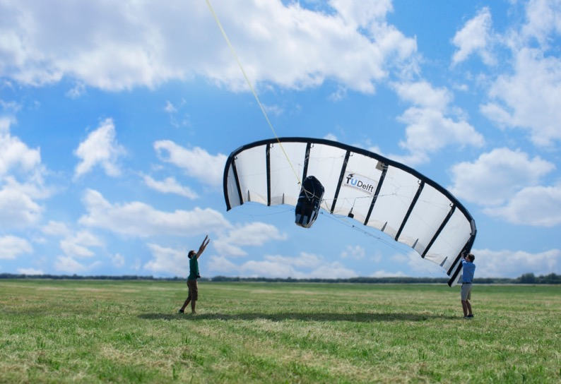
Scientific Focus

Slide 18
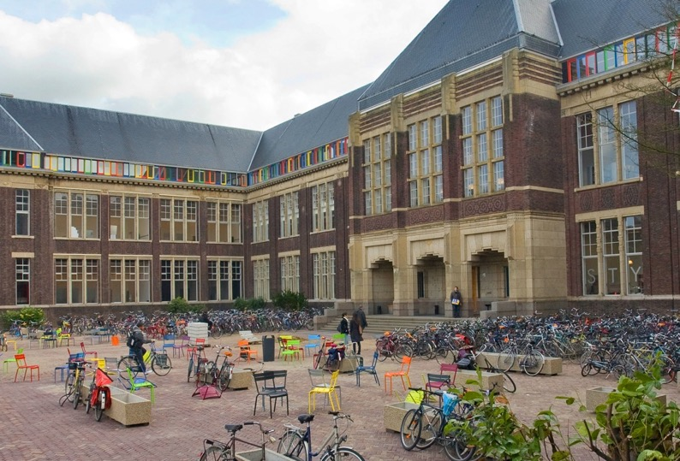
Architecture and the Built Environment
• Architecture
• Architectural Engineering & Technology
• Management in the Built Environment
• OTB Research for the Built Environment
• Urbanism

Slide 19
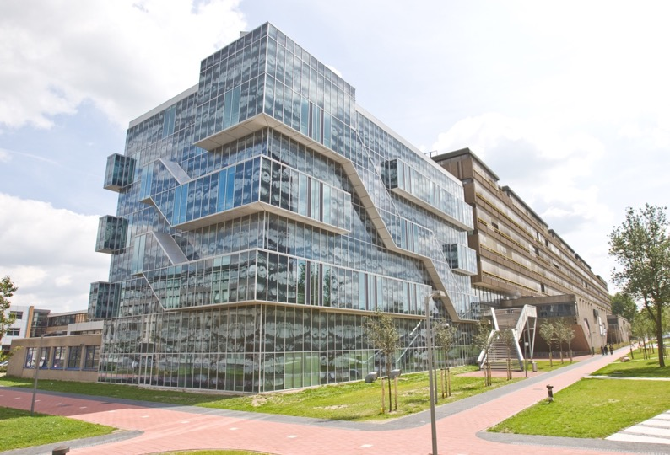
Civil Engineering and Geosciences
• Geoscience & Engineering
• Geoscience & Remote Sensing
• Hydraulic Engineering
• Structural Engineering
• Transport & Planning
• Water Management

Slide 20
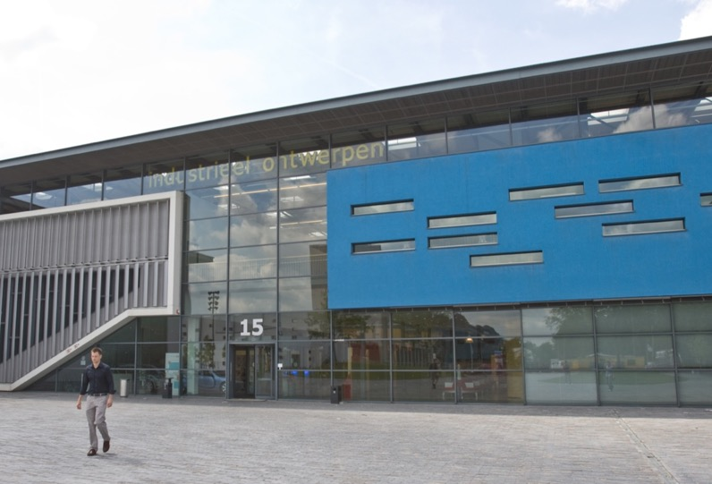
Industrial Design Engineering
• Design Engineering
• Industrial Design
• Product Innovation Management

Slide 21
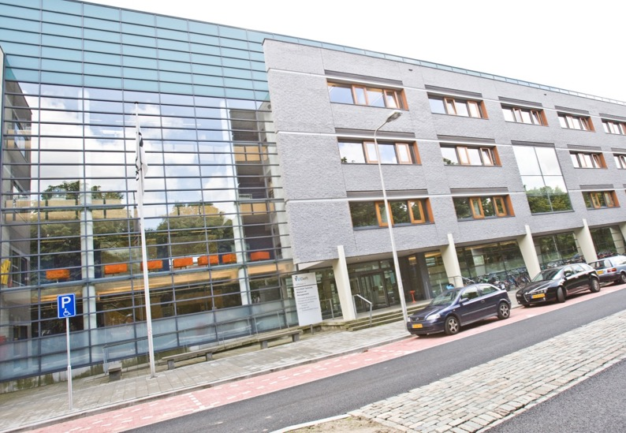
Technology, Policy and Management
• Engineering Systems & Services
• Multi Actor Systems
• Values, Technology & Innovation

Slide 22

Aerospace Engineering
• Aerodynamics, Flight Performance
and Propulsion & Wind Energy
• Aerospace Structures & Materials
• Control & Operations
• Space Engineering

Slide 23
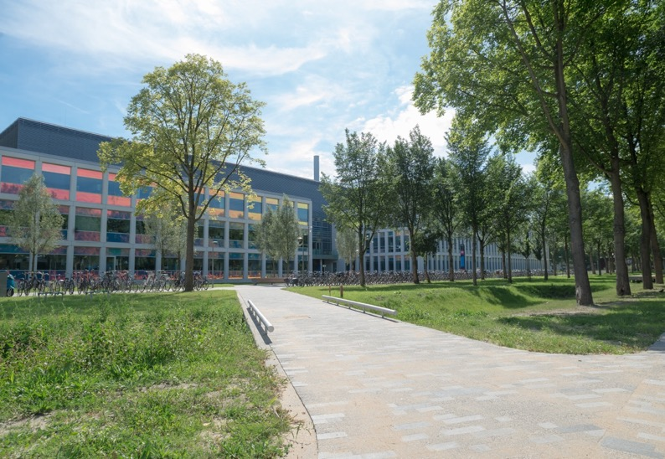
Applied Sciences
• Bionanoscience
• Biotechnology
• Chemical Engineering
• Imaging Physics
• Quantum Nanoscience
• Radiation Science & Technology

Slide 24
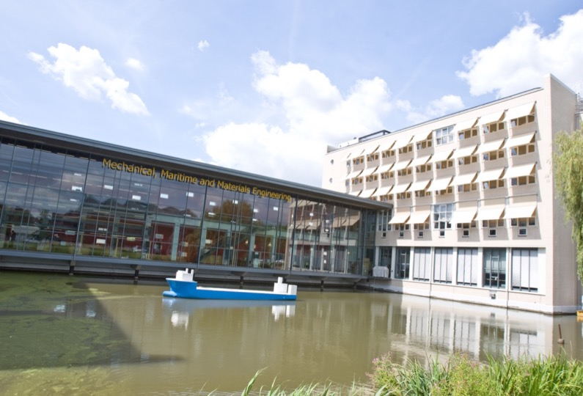
Mechanical, Maritime and Materials Engineering
• Biomechanical Engineering
• Cognitive Robotics
• Maritime & Transport Technology
• Materials Science & Engineering
• Precision & Micro-systems Engineering
• Process & Energy
• Systems & Control

Slide 25
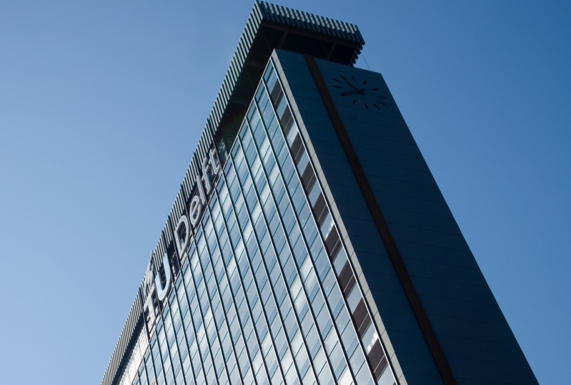
Electrical Engineering, Mathematics and Computer Science
• Applied Mathematics
• Electrical Sustainable Energy
• Intelligent Systems
• Microelectronics
• Quantum & Computer Engineering
• Software Technology

Slide 26
Delft Research-Based Initiatives
The Initiatives engage with societal and industrial partners, and highlight innovative science, engineering and design, stimulating multidisciplinary research.

Slide 27
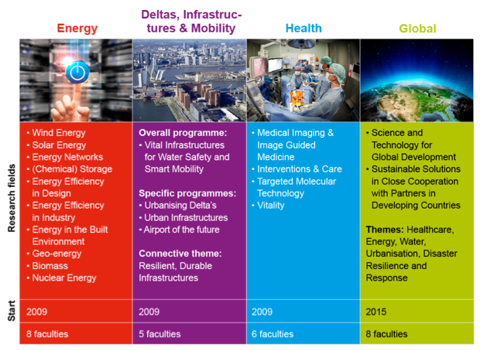
Notes:
The purpose of the TU Delft Research-based Initiatives (DRI’s), established in 2009, is to contribute to solving societal challenges within four themes: Health, Energy, Global Development, and Deltas, Infrastructures & Mobility. The Initiatives engage with societal and industrial partners, and highlight innovative science, engineering and design. In addition to stimulating multidisciplinary research that is in line with (inter)national agendas, the initiatives also have a strong inspirational effect on students and education.

Slide 28
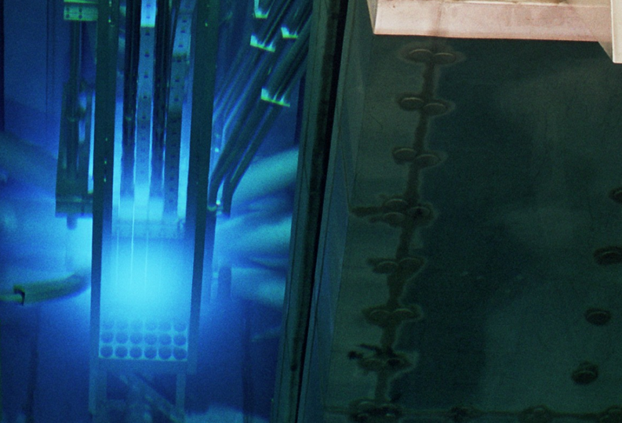
TU Delft Institutes
TU Delft aims to enhance its external profile with a view to better positioning itself to join national and international consortia and networks, and to become more attractive to top scientific talent.

Slide 29
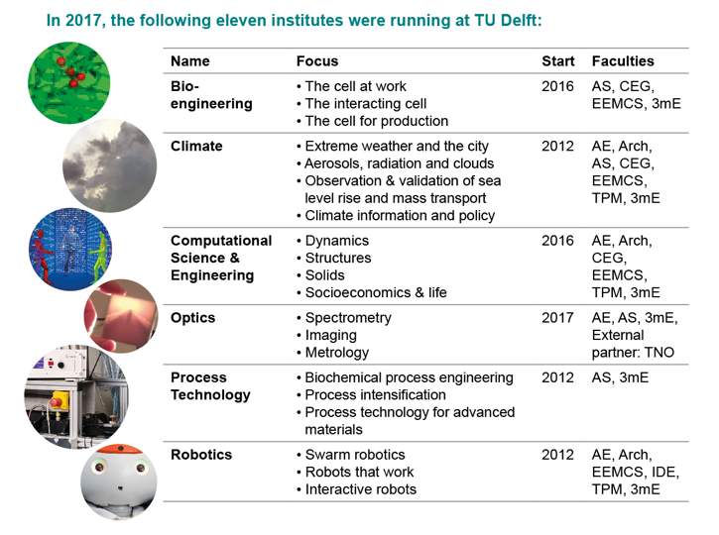
Notes:
In the course of 2017, one new Institute is expected to kick-off: the `Delft Design for Values Institute’, supported by the faculties of TPM, Arch, EEMCS and IDE.

Slide 30
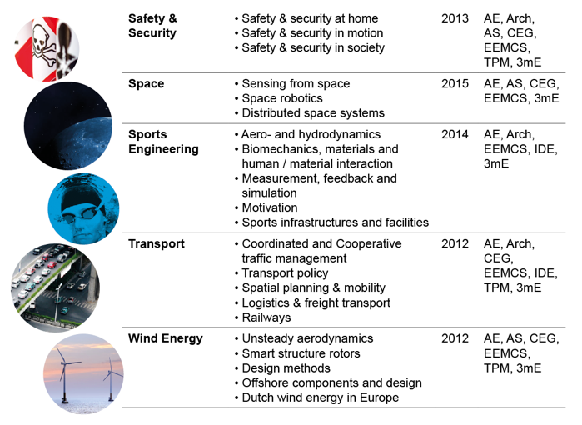
Notes:
In the course of 2017, one new Institute is expected to kick-off: the `Delft Design for Values Institute’, supported by the faculties of TPM, Arch, EEMCS and IDE.

Slide 31
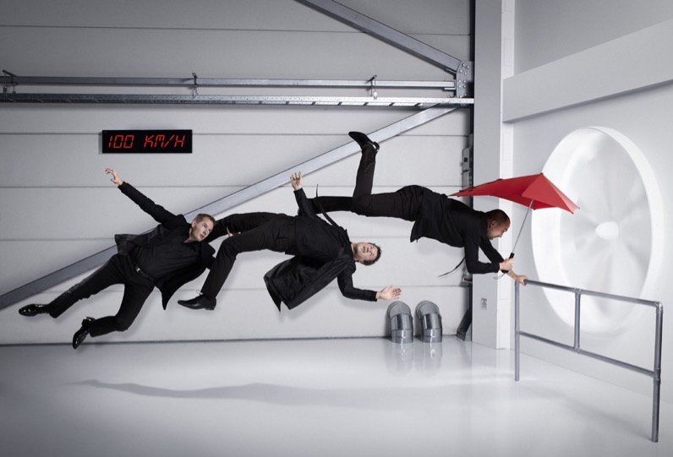
Technology Transfer

Slide 32
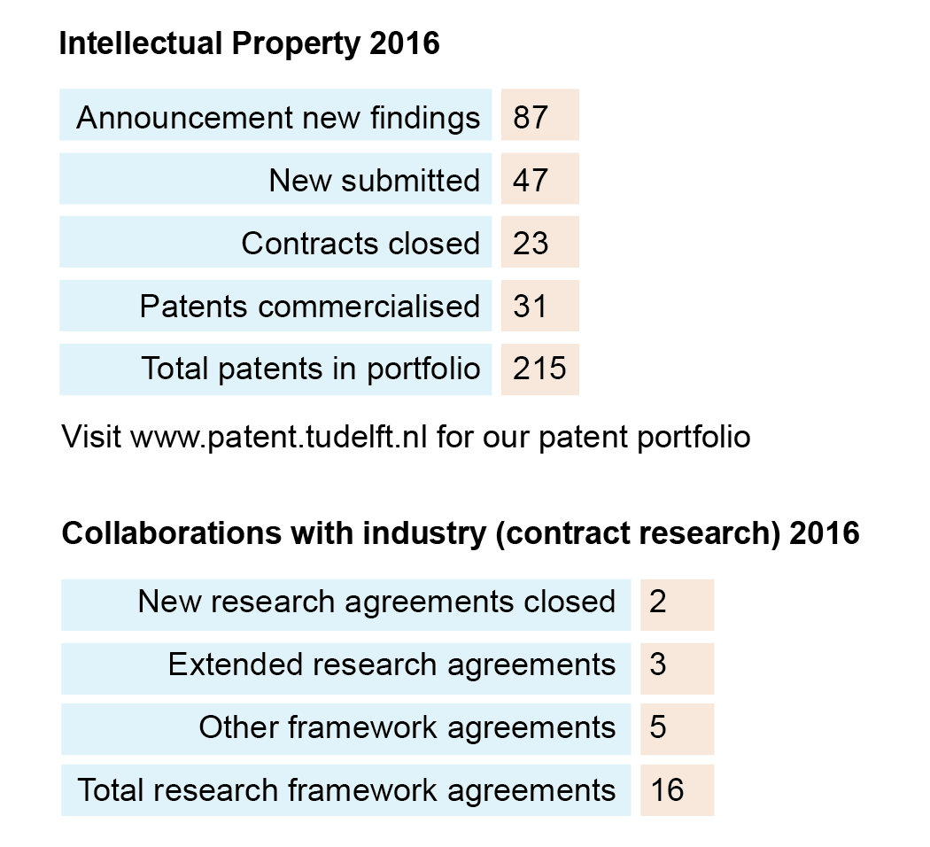
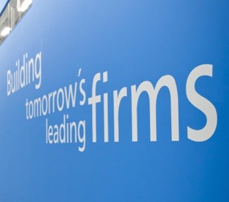
Notes:
As of 2004, Valorisation is one out of three core tasks of Dutch Universities. Valorisation concerns the creation of social and economic value based on scientific knowledge and skills. The Valorisation Centre stimulates and facilitates technology transfer and provides the necessary support for TU Delft scientists and support staff. This includes supporting researchers in attracting funding for research projects, setting-up innovative R&D initiatives and coordinating these large-scale programmes and projects, the management and commercialization of intellectual property, business development and establishing and maintaining long-term relationships with commercial partners.
Ranking Reuters Top 100: The World’s Most Innovative Universities
TU Delft jumped to 44th place, from 73rd place in 2015. Patents were an important factor in this improved rating.

Slide 33
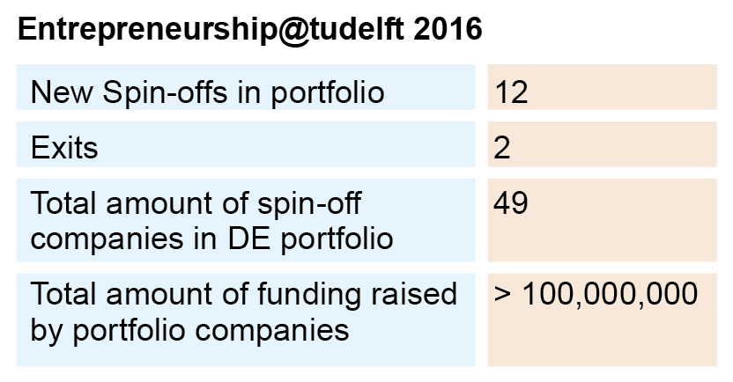
About Delft Enterprises (DE)
Delft Enterprises B.V. participates in innovative, early stage and technology-based spin-off companies of TU Delft. The aim to empower and speed up the development of these startups, as part of the ambition of the University to turn scientific knowledge into economic value.

Slide 34
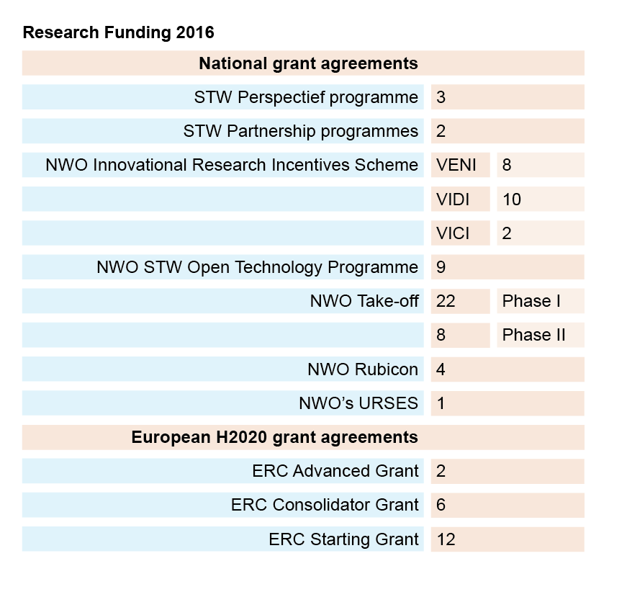
Notes:
In 2016, TU Delft passed the 100-million-euro milestone for H2020 project funding since the start of the programme. More than 140 projects are still in progress, in fields including robotics, flood disaster resilience, and responsible research & innovation. Between 30 October 2015 and 30 September 2016, TU Delft attracted around 44 million euros in project resources.
The European Institute of Innovation & Technology (EIT) is at the heart of the Horizon 2020 programme. The EIT exists of six ‘Knowledge and Innovation Communities’ (KICs), each geared to a particular societal challenge. TU Delft is involved in four of these KICs: Raw Materials, Health, Climate Change, and ICT.
The Foundation for Fundamental Research on Matter (FOM) awarded its 2016 Valorisation Prize of 250,000 euros to TU Delft Professor Ekkes Brück for his efforts in valorising the fundamental knowledge in the field of energy materials.

Slide 35

Printing without ink TU Delft spin-off Inkless ready for the next step forward
Visit www.tudelft.nl/en/technology-transfer for more information
Notes:
Printing without ink. Inkless, a TU Delft spin-off company, has the technology to do this without sacrificing print quality.
This can be done by carbonising the paper using a method developed in collaboration with the TU Delft Optics Research Group. Inkless has a good control over the carbonisation process.
This makes it possible to print without consumables on thin materials (such as paper), without giving in on the readability of the printed content. There are several patents on the technology.

Slide 36
TU Delft Alumni

Slide 37
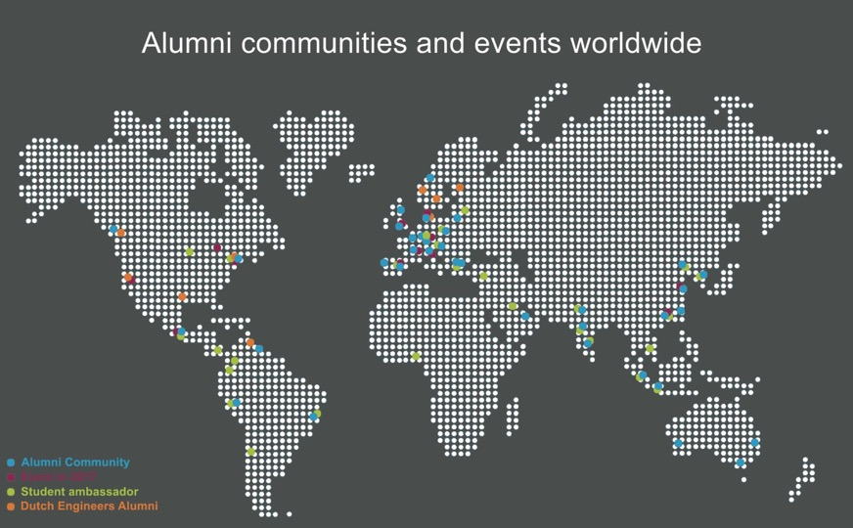

Slide 38
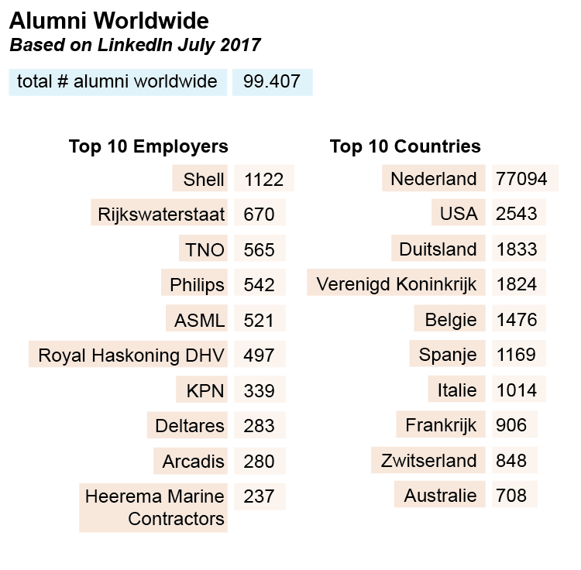

Slide 39



Famous Alumni from the past
Gerard Philips:
founder of Philips Electronics in 1891
Willem Schermerhorn:
first post-war prime minister, 1945
Hendricus van ’t Hoff:
winner of first chemistry Nobel prize, 1901
Martinus Beijerinck:
discoverer of the virus, 1898
Notes:
Also, 17 Historical Alumni have been added to the Alumni Walk of Fame
• Dr. ir. Lewis Cohen Stuart – 1848 Civil Engineering
• Prof. dr. ir Martinus W. Beijerinck – 1872 Chemical Engineering
• Dr. ir. Jacobus H. van ’t Hoff – 1871 Chemical Engineering
• Dr. i. Cornelis Lely – 1875 Civil Engineering
• Prof. dr. ir. Jacob Kraus – 1883 Civil Engineering
• Prof. dr. ir. Gerrit van Iterson – 1901 Chemical Engineering
• Ir. Maria Elisabeth Bes – 1904 Chemical Engineering
• Prof. ir. Marinus Jan Granpré Molière – 1907 Architecture
• Prof. dr. ir. Hein Israël Waterman – 1911 Chemical Engineering
• Prof. ir. Albert Sybrandus Keverling Buisman – 1912 Civil Engineering
• Prof. dr. ir. Albert Jan Kluyver – 1914 Chemical Engineering
• Prof. ir. Johannes Theodoor Thijsse – 1917 Civil Engineering
• Prof. ir. Willem Schermerhorn – 1918 Civil Engineering
• Ir. Dirk Coster – 1919 Electrical Engineering
• Ir. Johan van Veen – 1919 Civil Engineering
• Prof. dr. ir. Antonia Elisabeth Korvezee – 1922 Chemical Engineering
• Prof. dr. ir. Hendricus Jacobus van der Maas – 1923 Maritime Engineering

Slide 40
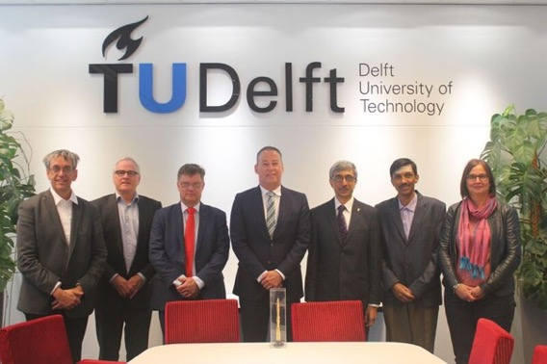
External relations
Notes:
Visit Deputy Director Dr Sharma, Indian Space Research Organisation (ISRO), Indian Satellite centre(ISAC) to TU Delft Executive Board and faculties, Delft May 2017

Slide 41
Network memberships in the Netherlands and Europe
4TU: Eindhoven University of Technology, Twente University, Wageningen
University and TU Delft
LDE: Leiden University, TU Delft, Erasmus University Rotterdam
CESAER: 51 Universities of Technology in Europe
IDEA LEAGUE: ETH Zurich, RWTH Aachen, Chalmers University of Technology,
Polytechnic Milan, TU Delft
EUA: European Universities Association

Slide 42
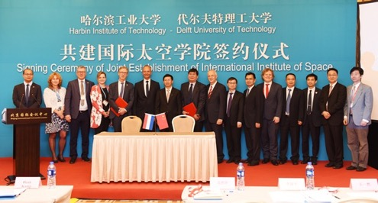
Strategic University Partners and Global Engagement Initiatives for worldwide Impact
Signing Ceremony of Joint Establishment of International Institute of Space, Harbin University of Technology and Delft University of Technology, Beijing 6 June 2017
Notes:
Global relations are crucial for the TU Delft to be able to find innovative solutions creating impact for tackling today’s global challenges and sustainable development goals (SDG) in both the regional and international context. The TU Delft strongest global relations not only focus on linkages with worldwide academic and research institutions but also build on an extensive network with (semi) government, NGO, health sector and business partners.
The basis of research and education partnerships originates from carefully established `bottom-up’ faculty relations: personal contact in researcher-to-researcher networks where curiosity and focus brings together academics on matching expertise creating synergy. Some of these TU Delft’s short and long term academic collaborations have grown into a number of joint research initiatives in both Europe and beyond. To actively further support academics in strengthening and broadening their collaborations into long-term relations as well as to encourage explicit focus on the importance of the university’s position in the world, the TU Delft has started rethinking its global alliances.
As such the TU Delft will aim to strengthen its relations with a select number of worldwide strategic university partners. In addition the TU Delft will position focused research fields for scientific collaboration in Brazil, China and India. While through the Delft Global Initiative the university wishes to boost science and technology for global development and impact in Sub Saharan Africa and South-East Asia. Many initiatives will directly or indirectly be supported by the university’s Valorisation Center; TU Delft international projects, funding and business relations units.
Finally in order to increase the TU Delft impact on the global education market the university will strengthen its’ thematic online education while collaborating with front runners in innovative education as well as start offering a relevant portfolio for working professionals and lifelong learners in a global environment.

Slide 43
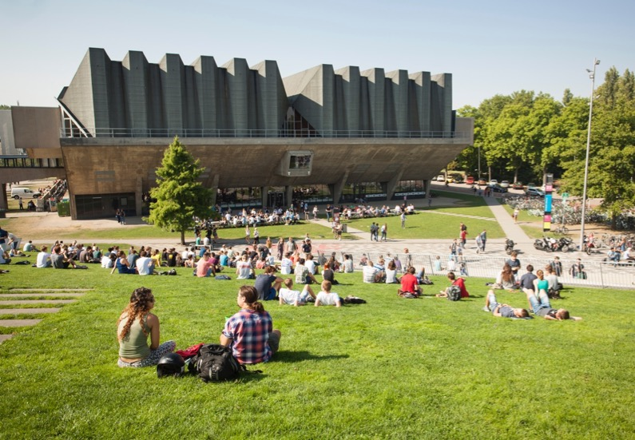
Campus & Facilities
• An inspiring Campus
• Research Infrastructure
For campus development see campusdevelopment.tudelft.nl
Notes:
An inspiring campus
TU Delft is an attractive `living campus’ with excellent facilities for education, research and innovation. It’s an inviting campus where people feel inspired to work and to be creative; an environment also that contributes to the community feeling. We continue renewing the campus to provide the best facilities at all times. We want to do this in a responsible manner and are firmly committed to the principles of sustainability.
Research Infrastructure
To attract outstanding scientific talent, conduct ground-breaking research and train new generations of engineers, TU Delft heavily relies upon excellent research facilities. We use our campus as a living lab which makes it possible for us and our research partners (for example TNO, Deltares and Microsoft) to test the real-life practicality of models simulated on computers. Something no other Dutch university can do on such a large scale. This is a defining element of TU Delft’s profile within the international research landscape.

Slide 44
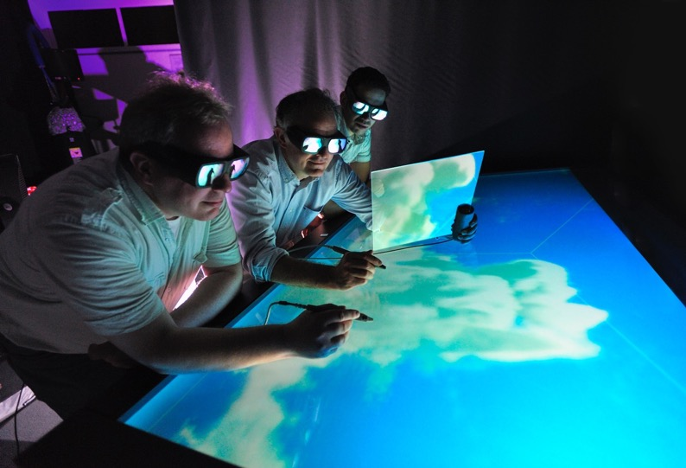
Research Facilities
Civil Engineering and Geosciences
• Cloud Lab
• Geodesy/GNSS Lab
• DiTT-Lab
• Smart Vehicle Lab
• Research Lab Automated Driving
• Drones for Traffic and Geological Research
• CT Scanner
• High Pressure & Temperature Facilities
• Geo-technical Centrifuge
• Macro Lab
• Micro Lab
• Biohazard 1 Wastewater Treatment Lab (ML1 lab)
• Water Engineering Experimental and Analytical Lab (e.g. GC, IC, HPLC, Water Isotopes)
• Flooms for Waves, Currents and Sediment Transport
• Jetski Mobile Platform for Coastal Fieldwork
Notes:
More information can be found at: labs.tudelft.nl

Slide 45
Applied Sciences
• Chemical Labs
• Fermentation Labs
• Molecular biology Labs
• Bioprocess Pilot Facility
• Imaging Facility
• Advanced Imaging Labs
• Laser Labs
• Cleanrooms
• Nuclear Research Reactor, incl. Neutron and Positron Beam-line Instruments and Irradiation Facilities
Aerospace Engineering
• Aeroplane Hangar
• Cessna Citation II Jet Aircraft
• Cleanroom for Satellite Building
• Flight Arena ‘Cyberzoo’
• Flight Simulator Simona
• Kite Laboratory
• Micro Air Vehicle Laboratory
• Propulsion Lab (being built now)
• Structures & Materials Lab
• Wind Tunnels (Low and High Speed Tunnels)

Slide 46
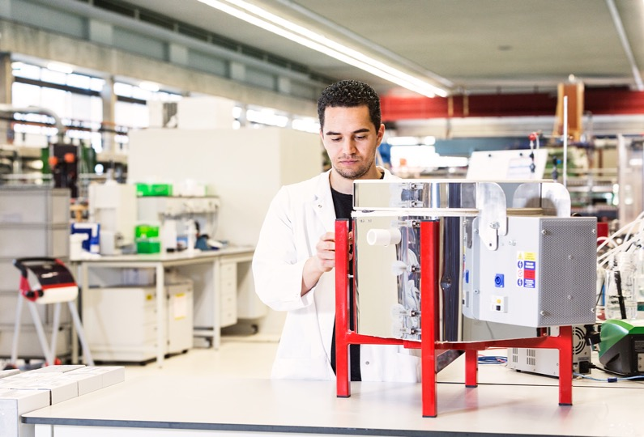
Mechanical, Maritime and Material Engineering
• Cleanroom for Micro/Nano Engineering Lab
• Driving and Racing Simulator Labs
• Fluid Mechanics Lab
• Graphene and Thin Film Deposition Lab
• Materials Lab
• Mechatronics Lab
• Perfect Reactors Lab
• Process Technology Lab
• Robotics Lab
• Flume Tank and 2 Towing Tanks
• Delft Lab for Neuromuscular Control
• AGV-Lab
• Optics Lab
• Fuel Cell Lab
• Hexamove/-pod
• Cavitation Tunnel
Notes:
citg

Slide 47
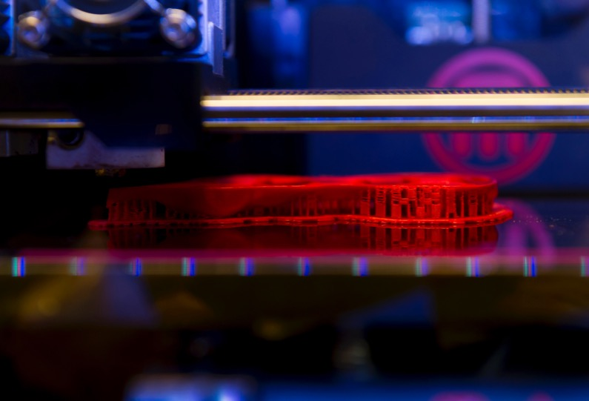
Industrial Design Engineering
• Applied Labs
• Aviation
• Connected Everyday Lab
• Emerging Materials Lab
• Foundational Labs
• ID-StudioLab
• Model making and Machine Lab
• Perceptual Intelligence Lab
• Physical and Ergonomics Lab
• Product Evaluation Lab
Architecture and the Built Environment
• Architecture Model Hall
- 3D Printers
- 3D Lab
- Lasercutters
- CNC Milling Machines
- Render Farm
- Sense Lab
- Product Development Lab
• Architecture Library:
- 35,000 Books
- 14,000 Maps
- 550 Atlases
- 260 Magazine Titles

Slide 48
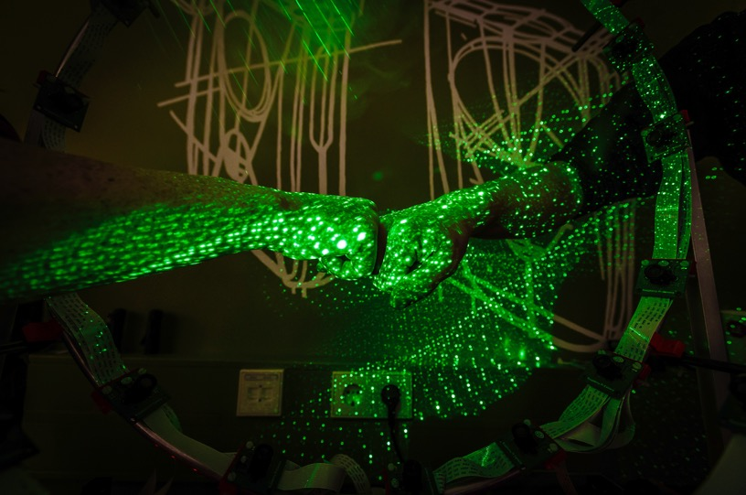
Technology, Policy and Management
• Policy Analysis Simulation Lab
• Serious Game
Electrical Engineering, Mathematics and Computer Science
• Else Kooi Lab, Cleanroom for Microsystems
• Electrical Sustainable Power Lab
• INSYGHTLab for Computer Vision, Interactive Intelligence and Visualisation
• Radar Labs with PARSAX and MECEWI Radars and the Radar Facilities TARA and IDRA
• DUCAT Antenna Measurement Chamber
• Photovoltaics Laboratory
• Tellegen Hall

Slide 49
History of the University

Slide 50
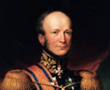
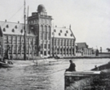
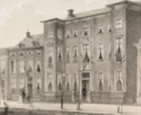
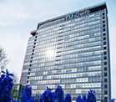
1842-1864:
Royal Academy
1905-1986:
Institute of Technology
1842-1864
1864-1905
1905-1986
1986-present
1864-1905:
Polytechnic School
1986-present:
Delft University of Technology
Notes:
1842-1864: Royal Academy
On 8 January 1842, King Willem II founded the ‘Royal Academy for the education of civilian engineers, to serve both nation and industry, and of apprentices for trade’. The academy also educated civil servants for the colonies and revenue officers for the Dutch East Indies.
1864-1905: Polytechnic School
An Act was passed on 2 May 1863 imposing regulations on technical education as well as bringing it under the influence of the rules applying to secondary education. Then, on 20 June 1864, a Royal Decree was issued ordering the Royal Academy in Delft to be disbanded to make way for a new ‘Polytechnic School’. The school went on to educate architects and engineers in the fields of civil engineering, ship-building, mechanical engineering and mining.
1905-1986: Institute of Technology
On 22 May 1905, an Act was passed acknowledging the academic level of the Polytechnic School’s technical education and it became a Technische Hogeschool, or Institute of Technology. Queen Wilhelmina attended the Institute’s official opening ceremony on 10 July 1905. The Institute’s first Rector Magnificus was the Professor of Hydraulic Engineering ir. J. Kraus. The Institute was granted corporate rights by an Act passed on 7 June 1956.
1986-present: Delft University of Technology
An Act which took effect on 1 September 1986 officially transformed the Institute of Technology into Delft University of Technology, abbreviated to TU Delft from the Dutch name Technische Universiteit Delft.

Slide 51
Rankings

Slide 52
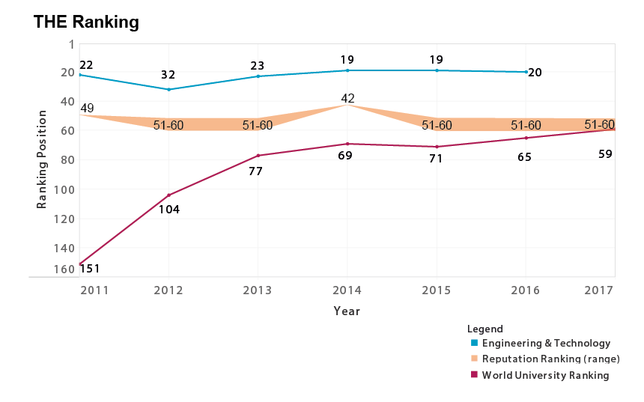

Slide 53
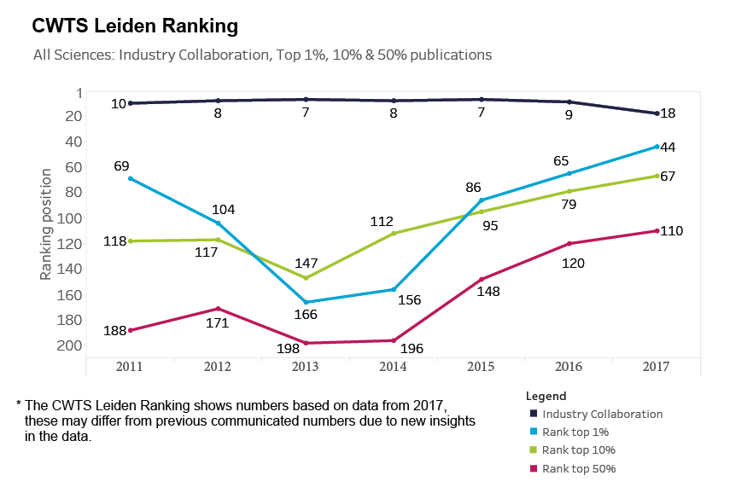

Slide 54
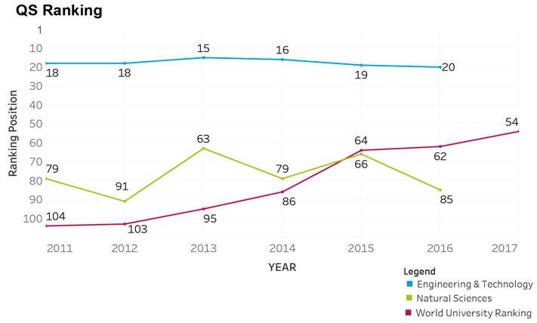

Slide 55
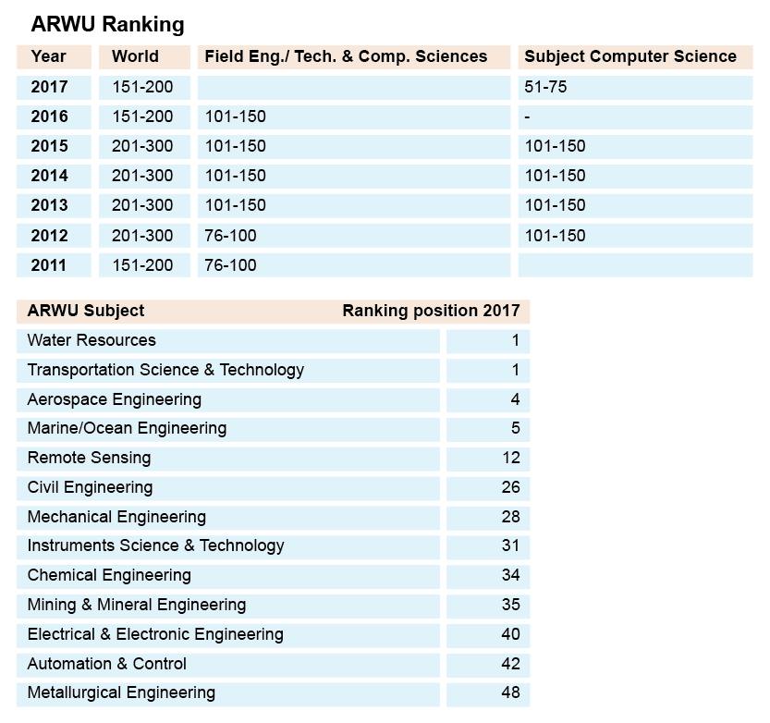

Slide 56
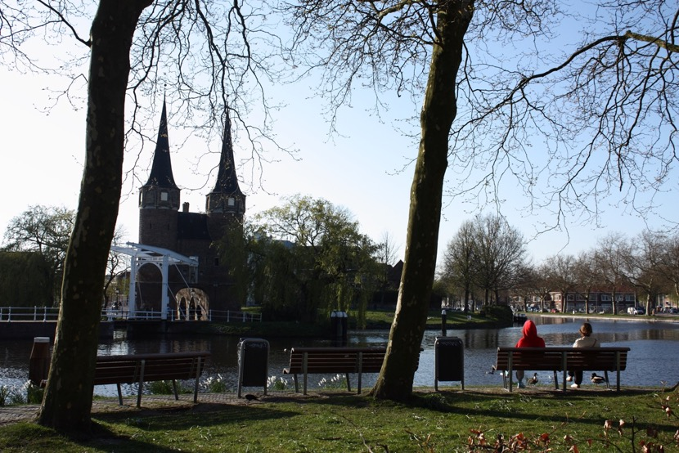
The City of Delft
City of Delft statistics
Square kilometres: 24
Population: 101,033
Cafés, bars and restaurants: 296
Notes:
Delft is a historical city that was established in the 13th century with a rich history including the world-famous Delft Blue china, celebrated painters such as Johannes Vermeer and scientists such as the inventor of the microscope Antoni van Leeuwenhoek. Delft’s slogan is: `Delft, creating history’. The city of Delft is strategically located at the heart of the Dutch knowledge economy and is within easy reach of the TU Delft campus by bike or public transport. The close connection between the city and the University brings together the best of both worlds.
Over the past two decades, Delft has rapidly transformed from an industrial centre into a hub for the Dutch knowledge economy. But Delft is also constantly looking to the future to ensure the city remains vibrant and prosperous. The university and companies based in Delft play an important role in this mission. The University and the city work more and more together in order to become a strong team in the battle for brains. Internationalisation, accessibility of the campus, estate management, attractiveness for students, researchers and tech companies to come and stay in Delft as well as community engagement are on the agenda.

Slide 57
Connectivity
To Rotterdam by car: 15 km, 20 min
To Rotterdam by train: 10 services per hour, 15 min
To Amsterdam by car: 66 km, 44 min
To Amsterdam by train: 4 services per hour, 58 min
To Schiphol airport by train: 6 services per hour, 40 min
Impact TU Delft on the City of Delft
• 1 in 10 residents is a TU Delft student
• 1 in 5 catering facilities in Delft would not exist without TU Delft
• 1 in 10 retail concerns in Delft would not exist without TU Delft
• TU Delft employs 5270 FTE directly and another 1850 FTE indirectly
• TU Delft and its students, employees and visitors account for 15%
of Delft’s employment

Slide 58
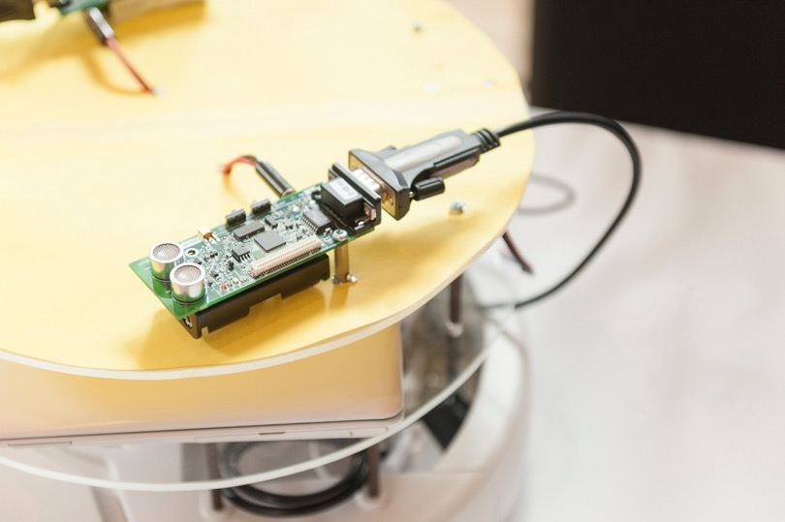
www.tudelft.nl/factsandfigures

