Slide 1
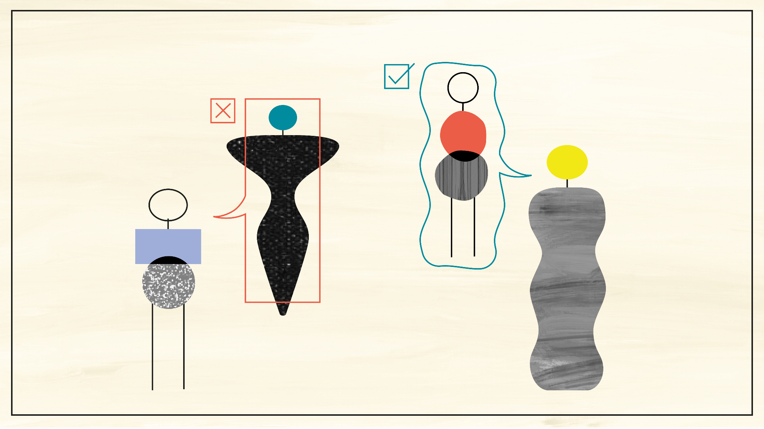
Diversity & Inclusion policy NWO - granting
Astrid Zuurbier| TUD Diversity week|
6 Octobre 2021

Slide 2
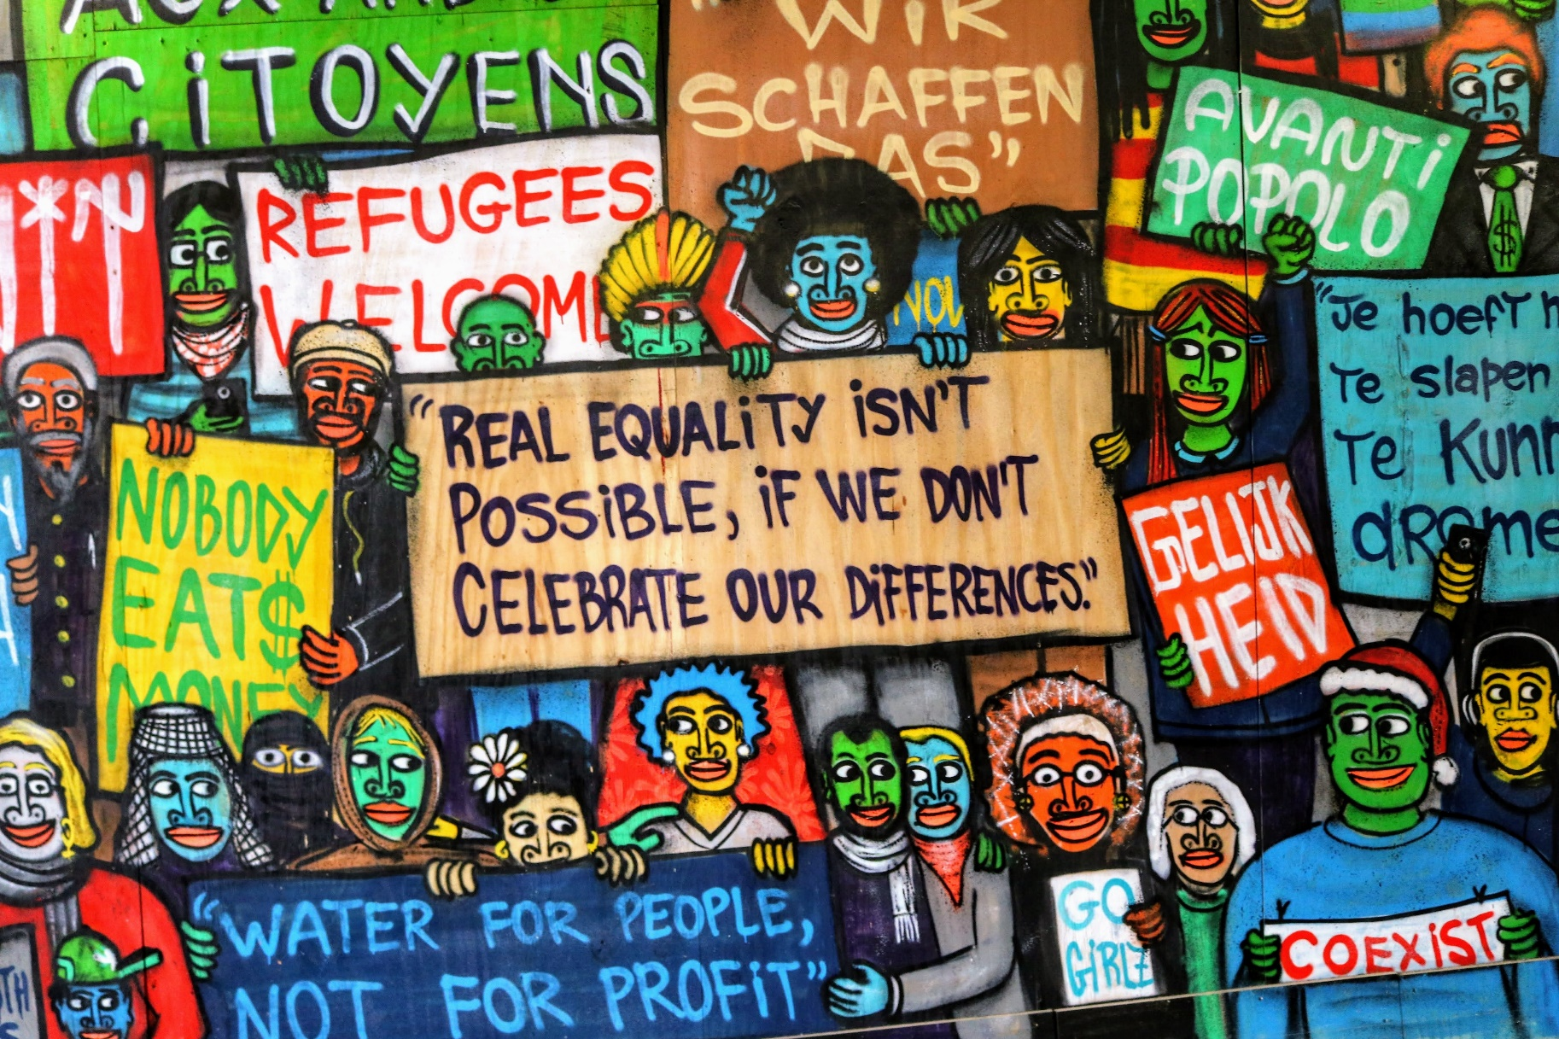
Diversity ambition
Inclusive culture: no place for intentional or unintentional barriers due to cultural, ethnic or religious background, gender, sexual orientation, health, or age.
Adapt funding instruments and procedures
Training of stakeholders
Diversity in the design and realisation of projects and programmes.
Diversity: “Diversity works” benefit from the divers expertise, skills and perspectives of scientists
Attract and retain more researchers with a migrant background and women in STEM
Services for other underrepresented groups

Slide 3
Mile stones
NWO
Inclusive assessment video & instructions: https://www.nwo.nl/en/inclusive-assessment
Mozaiek 2.0: https://www.nwo.nl/en/researchprogrammes/mosaic
Insight Out for women in STEM
Incentive Grants for Women in STEM: on hold for evaluation
Introduction narrative CV
Hestia: impuls for refugee academics https://www.nwo.nl/en/researchprogrammes/hestia-impulse-refugees-science
Provision for pregnant applicants in Talentprogram
In national collaboration
National Action Plan D&I Higher education and research
Recognition & rewards initiative
European Gender Summit (October 2019 in Amsterdam)

Slide 4
In the pipe line
Inclusion
Facilities to ensure a safe and welcome environment for reseachers
Training & instructions in inclusive collaboration in committees, consortia etc.
Include the diversity of the research objects in quality assesment
Diversity
Sandpit call for universities: how to attract and retain researchers with migrant background
Incentive Grants for Women in STEM 2.0
Diversity Data Dashboard
Underrepresented target group oriented services & facilities
Increase age diversity in NWO committees

Slide 5
More information:
NWODI@nwo.nl
NWO D&I Granting team:
Astrid Zuurbier (coordination)
Annemieke van der Kooij (underrespresented target groups + procedures)
Channah Herschberg (inclusive assesment)
Arina Schrier (inclusive collaboration)
Arnold Lubbers (researchers with migrant backgroun)
Eveline Mezger (women in STEM)
Poppy Savenije (communication)

Slide 6
Question? Ideas? Needs? Tips?

