Slide 1
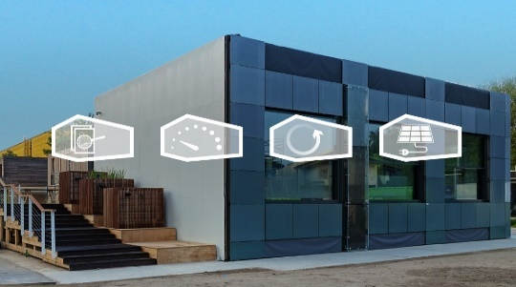
Advanced Zero-Energy Design: Validate Your Building’s Energy Performance
Start Date: October 6
How can buildings be made net zero energy, in different climates? Take this hands-on, interactive course to find out. Learn to develop zero-energy designs and how to validate your design with energy performance calculations.
https://online-learning.tudelft.nl/courses/advanced-zero-energy-design/
Spatial Circularity Strategies for Sustainable Regional Development
Start Date: October 6
Gain insights and tools to develop spatial strategies, plans and actions to support the transition towards circularity in your city or region.
https://online-learning.tudelft.nl/courses/spatial-circularity-strategies-for-sustainable-regional-development/
Buildings as Sustainable Energy Systems
How to realize energy-efficient and comfortable buildings? Find out with our online 4 step program. Learn all you need to design more sustainable buildings, whilst improving the thermal quality and comfort of their indoor environment.
https://online-learning.tudelft.nl/programs/buildings-as-sustainable-energy-systems/

